Slide 1
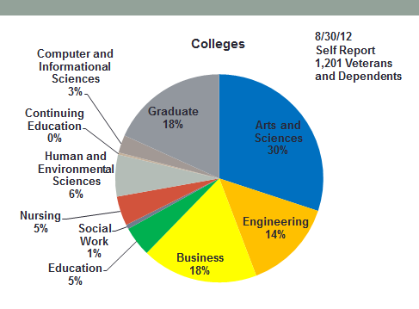
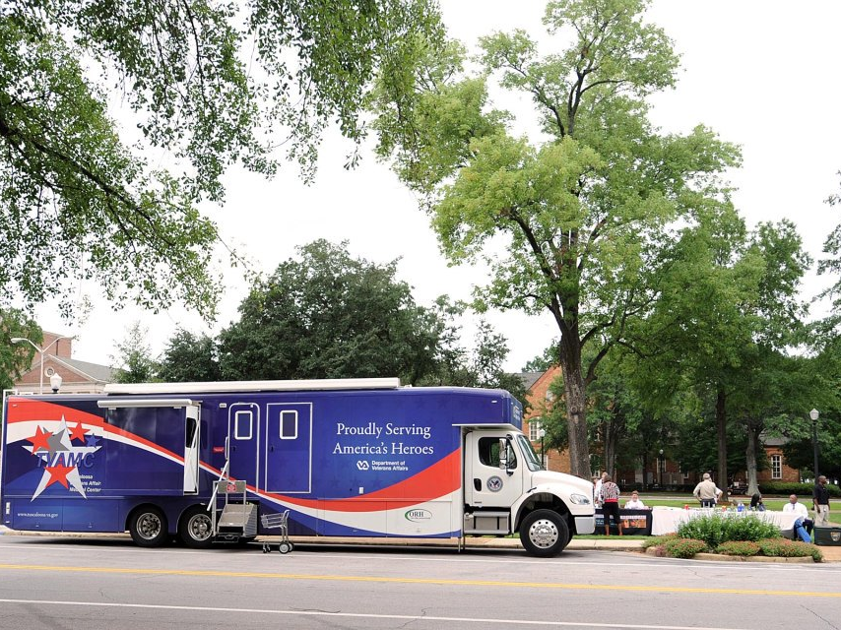
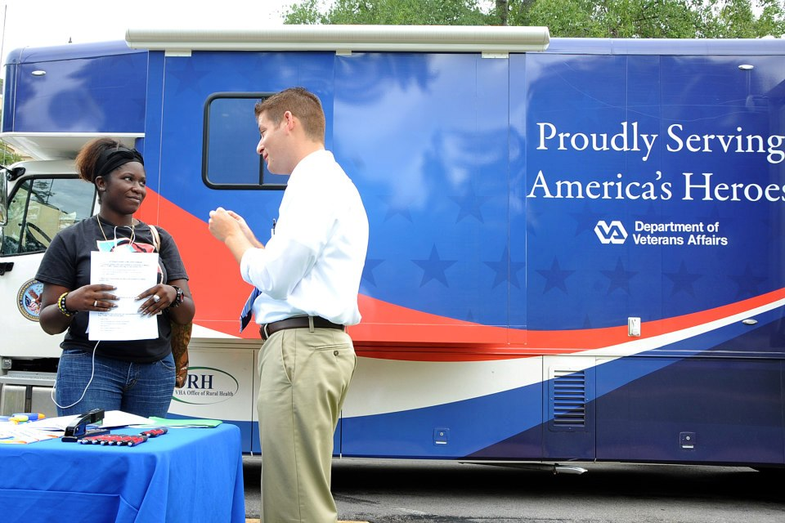
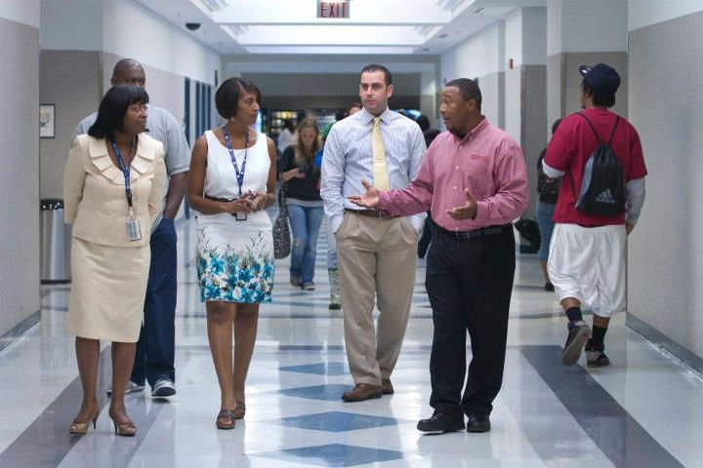
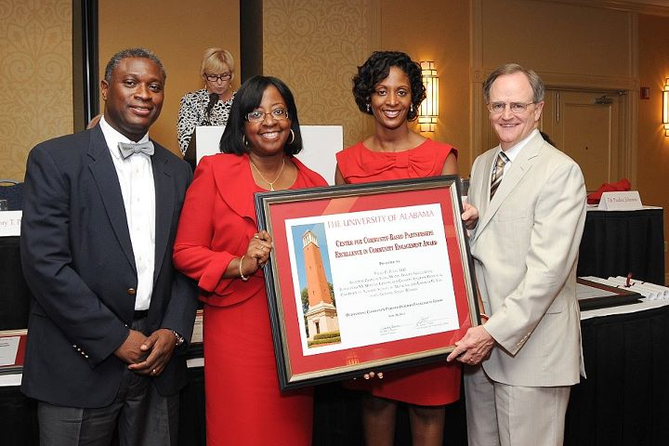
Department of Veterans Affairs
Veterans Integration to Academic Leadership (VITAL)
Dr. Velda Pugh, Project Director
Lawanda Vanhorn, LGSW, VITAL Coordinator
Michael Walker, Intern
VITAL Initiative
VITAL’S Outreach Events
VITAL and the University of Alabama
VITAL and Shelton State
VITAL Case Studies
Implemented September 2011
Tuscaloosa VA Medical Center (TVAMC) was one of 5 VA medical centers across the country selected to offer services to Veteran-students
Our Promises
Provide care second to none
Maintain and expand Veterans healthcare services
Ensure that every Veteran is satisfied based on the outcome
GOALS
Provide an opportunity to form a bridge between local colleges/universities and TVAMC
Serve as a safe-haven for Veterans who have decided to pursue a higher education
Educate faculty/staff about Military culture
Connect Veteran-students to information and resources within and outside of the Medical Center
BENEFITS
Successful academic achievements
Peer Support
Enhanced community partnerships
Decreased communication barriers with faculty/staff
Specific Liaison to the medical center who can assist with enrollment, scheduling appointments
Support with campus process issues related to academics or behavioral concerns
VITAL staff participates in numerous outreach activities each month in an effort to connect with Veteran -students on campus.
Data obtained from Shelton State Community College’s VA Certifying Official depicts that 196 Veterans and dependents are utilizing education benefits.
VITAL assists with…
New Veterans Orientation
Campus Veterans Association
Veteran’s Day events
On-campus information & referral
Case Study #1
One Veteran-student #1 had been in school for a number of years.
He had several medical withdrawals over the course of his academic career in addition to a number of incompletes.
The Veteran was no longer eligible for any type of financial aid assistance and his education benefit would not be extended.
The Veteran was offered continuous support and encouragement through the program. The Social Work Coordinator became a liaison and often advocated for the Veteran.
In August, he graduated from college.
Case Study #2
Veteran-student #2 was referred to the program by way of the Medical Center Director shortly after VITAL was implemented.
Secondary to a diagnosis of PTSD, the Veteran presented with tremendous bouts of anger and anxiety. He spoke of feelings of paranoia at times and fear of not knowing what he would do if he felt threatened by anyone, stranger or not.
The Veteran was offered support through VITAL’s Peer Support Group.
Over the next several months, he became more acclimated to school. Unfortunately, the anniversary of the loss of fellow soldiers and his sustained injuries approached. Although within weeks of graduating, the Veteran began to become angry, depressed and anxious.
Aware of VITAL’s partnership with their campus, school personnel contacted the VITAL Social Worker who agreed to serve as the Veteran’s independent study liaison until he was cleared to return to campus. Assignments were given to her and forwarded to the Veteran.
In the meantime, the Veteran received the appropriate evaluations, met with the Dean of the College and within a week was granted permission to return to complete his degree.
He graduated in August.
According to data obtained from the University of Alabama’s Office of Veteran and Military Affairs, there are currently 453 Veterans utilizing education benefits on campus.

