Slide 1
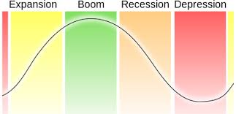
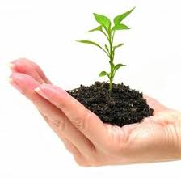
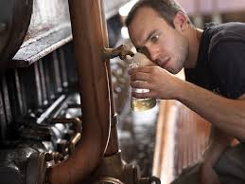

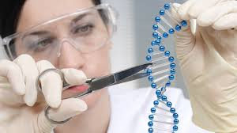
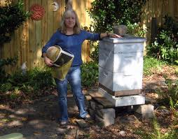
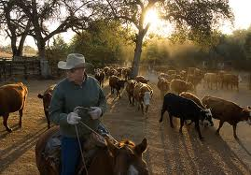


Slide 2
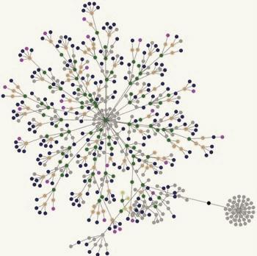


The Value Chain of
Colorado Agriculture:
A Community, University
and State Partnership

Slide 3
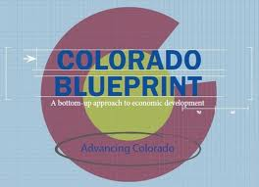
Build a Business-friendly Environment
Recruit, Retain and Grow Companies
Improve Access to Capital
Create and Market a Stronger Colorado Brand
Educate and Train the Workforce of the Future
Cultivate Innovation and Technology

Slide 4
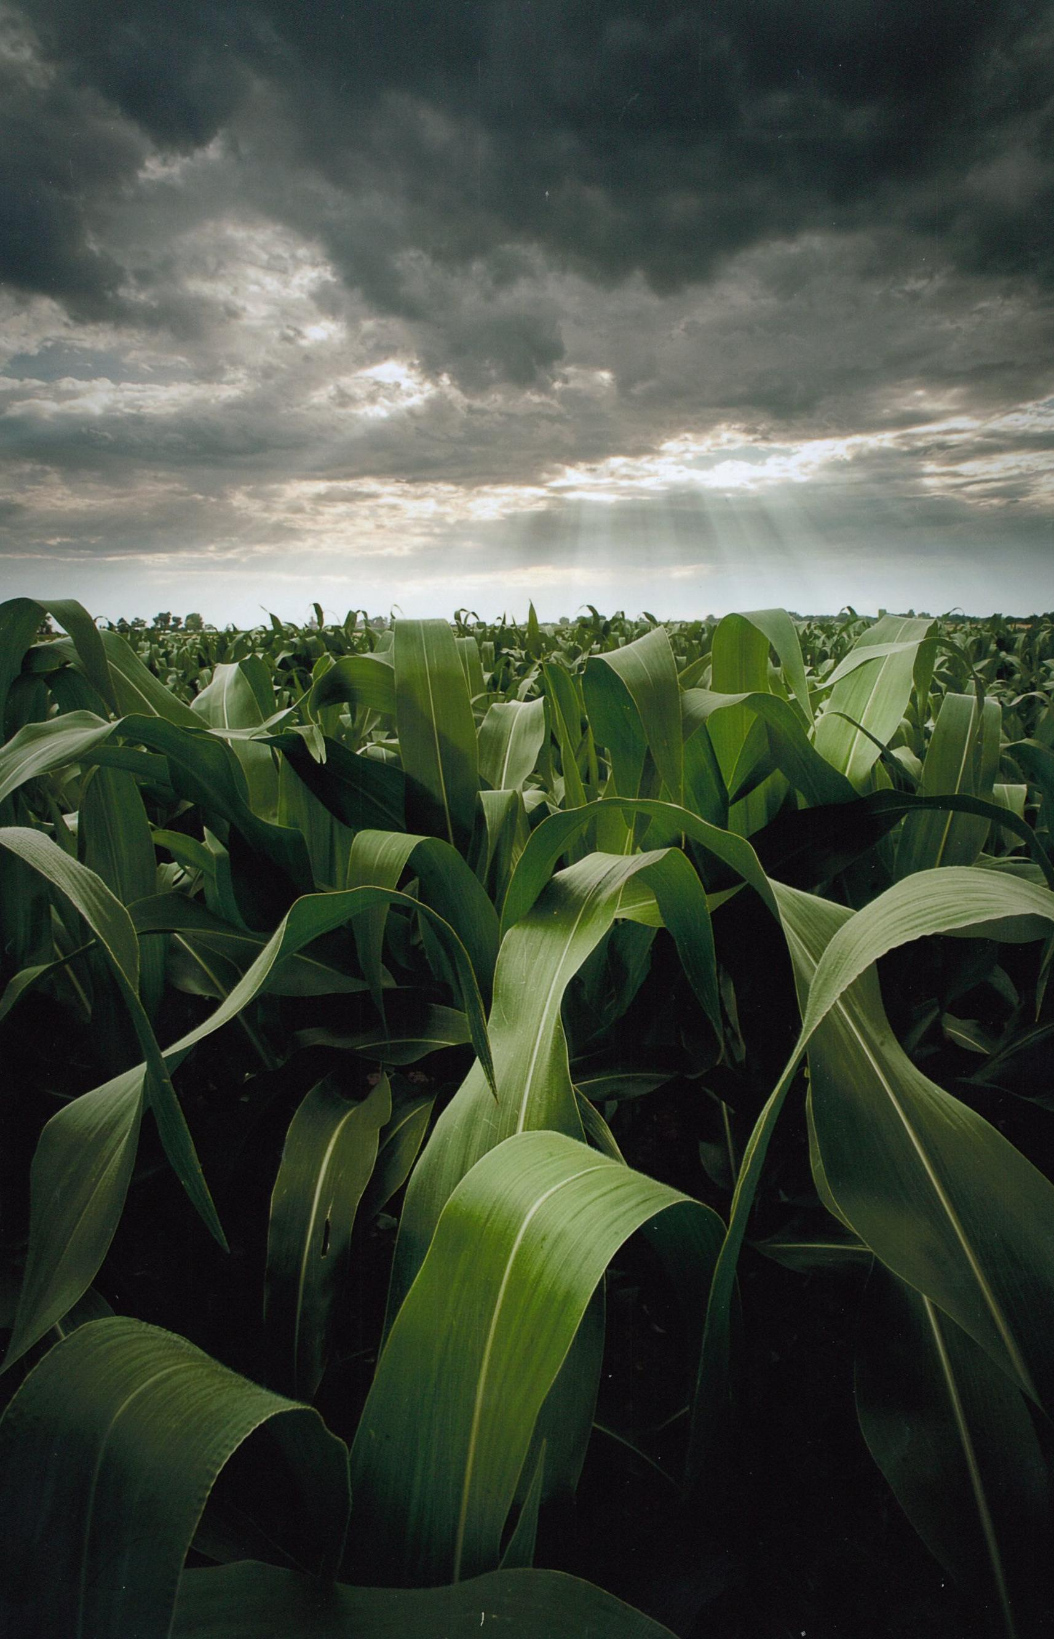

Slide 5
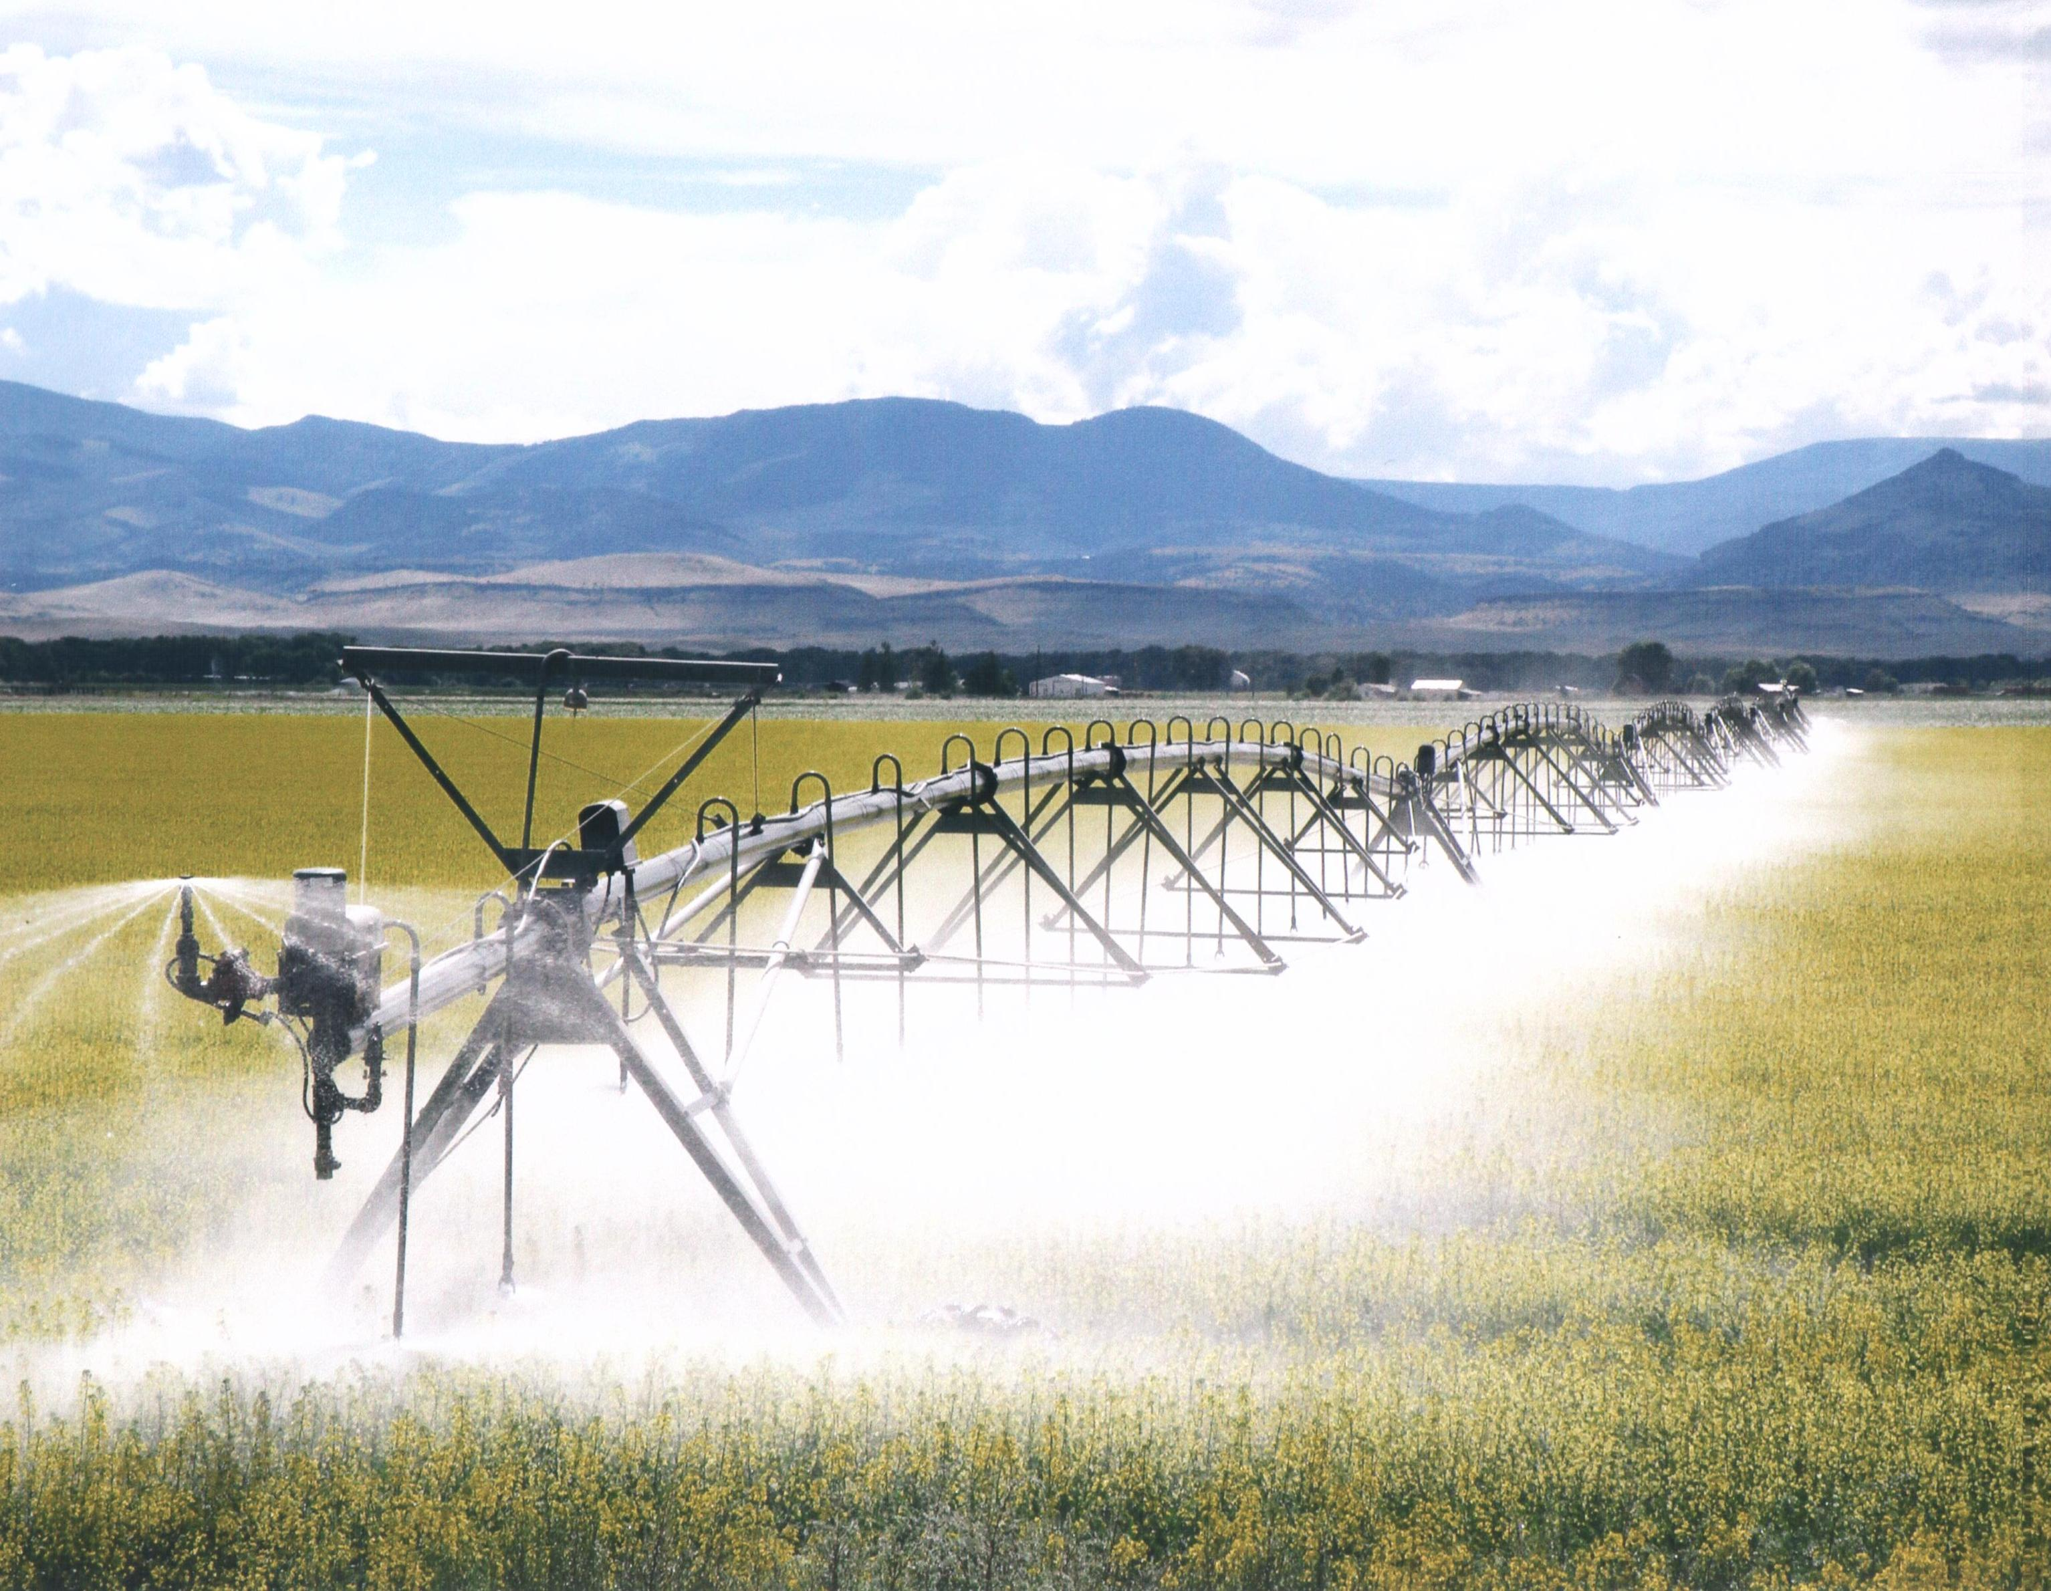

Slide 6
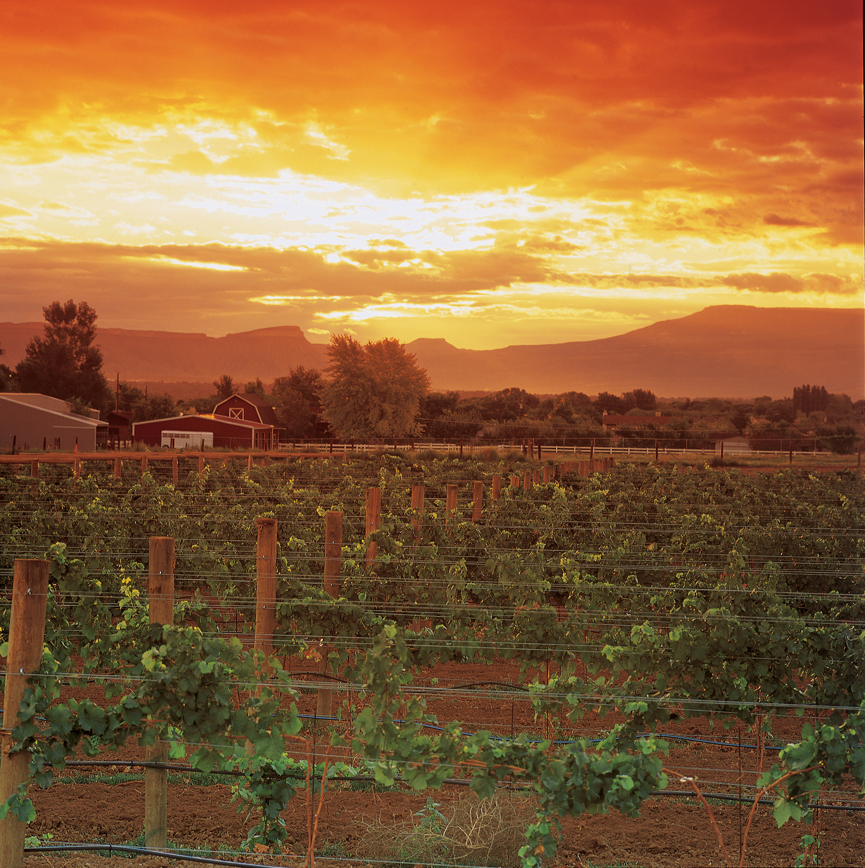

Slide 7
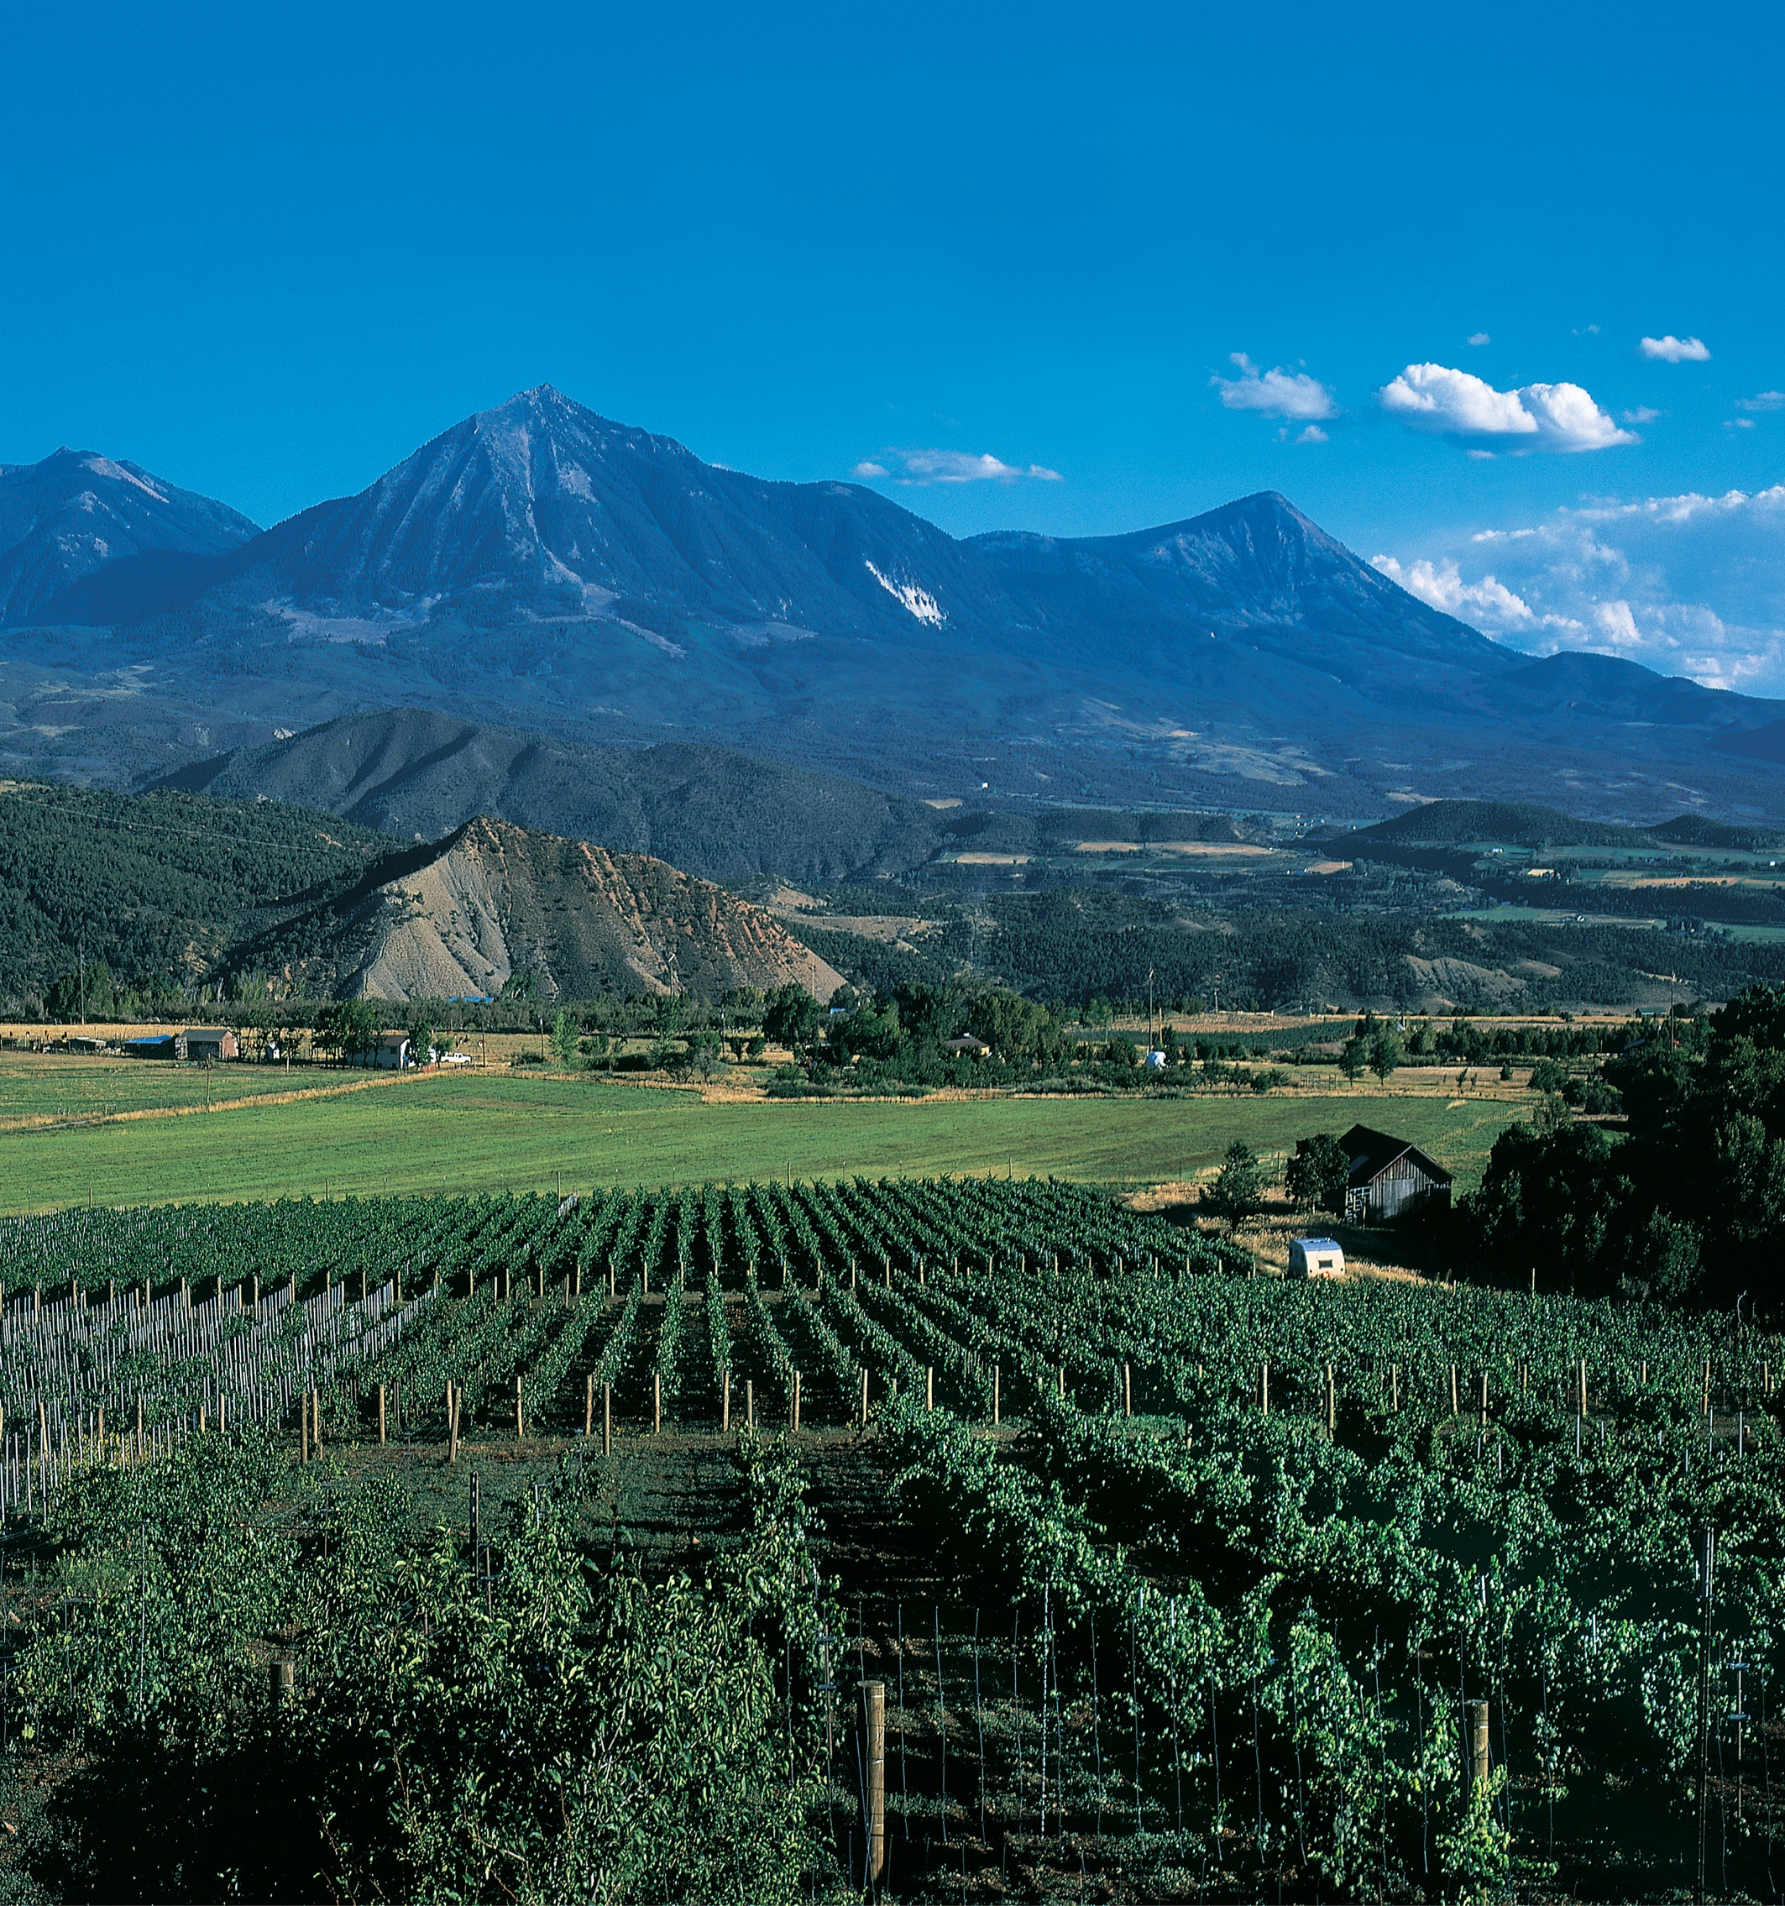

Slide 8
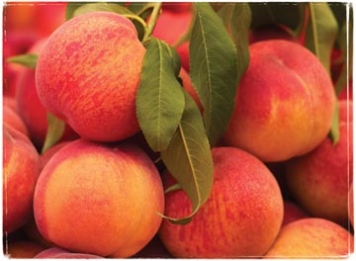

Slide 9
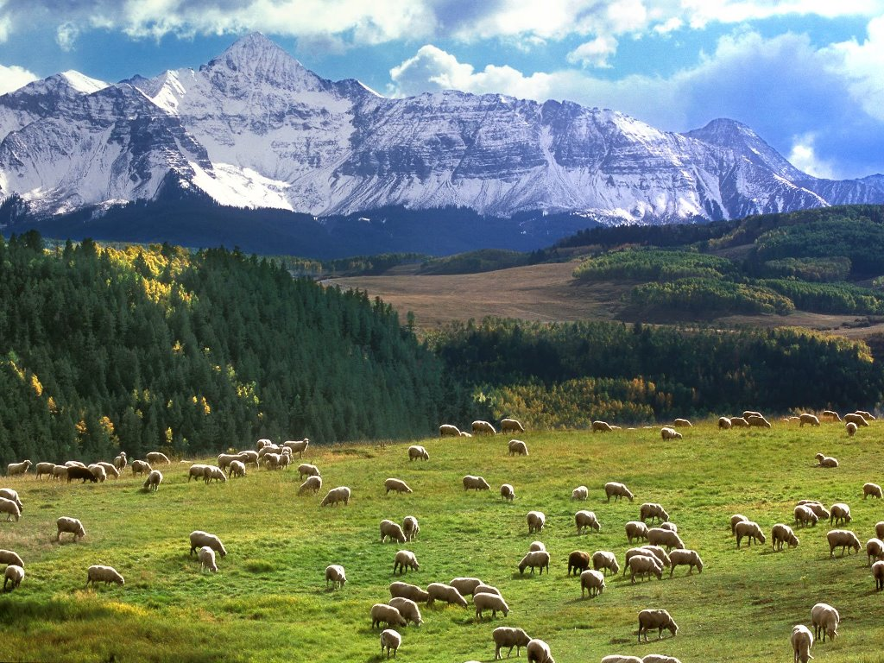

Slide 10
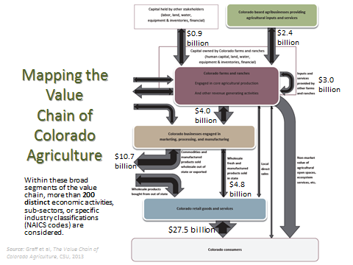

Slide 11
The Value Chain of Colorado Agriculture:
A Community,
University and State Partnership
Tom Lipetzky
Colorado Department of Agriculture
Kathay Rennels
Office of Engagement
Colorado State University

