Slide 1
College Readiness for Rural Youth
Presenters:
Jason Hedrick
Jeff Dick
Mark Light

Slide 2
College Readiness for Rural Youth
Reason for College Readiness Programming in our Region (JEFF)
College Readiness for Rural Youth Curriculum (JEFF)
How We Integrated it into NW Ohio and Data (MARK)
Conclusion and Sharing – QR Coded handout (MARK)

Slide 3
Integration into Northwest Ohio Schools
Real Money Real World – a financial education program for youth in high school
Awareness of the interrelationships between education, job, and money
Added College Readiness as a component of this program
Better education = better career
Education has a financial cost
Both programs linked together well
Local colleges hosted College Readiness for rural youth events

Slide 4
Target audience

Slide 5
Two Essential Components
Aspirations – the choices you make now effect your academic future
Awareness – What are your education options?
Ultimate College Challenge
Will College Mascots Let you in?
Create aspirations of students attending college, developing awareness of college opportunities, gaining understanding of basic academic requirements for college admissions, and develop understanding that loans and scholarships can help students afford college.

Slide 6
Ultimate College Challenge
Grade: 7th – 10th
Group: Divide class into groups of no more than 8 members
Time frame: 40-50 minutes
Materials: Dry erase boards, dry erase marker, dry eraser, and definitions (handout)
Directions: provide dry erase materials to each group, start slide with T&F questions, provide time for discussion and have them all flip boards at same time.
The groups will answer a number of true/false questions- 1 point for correct answer
Team with the most points at the end wins
Prep Questions:
What types of classes did you have to take in high school to get ready for college?
What kinds of colleges are you looking for?
What colleges are nearby?

Slide 7
Sample Questions…
There are 2,500 two and four-year colleges and universities in the country.
There are more than 4,000 two and four year colleges and universities in the country. With this many options, you’re bound to find a school that fits your needs and personality.
25% percent of students aged 16-18 are not sure they know how to achieve their college goals.
This number is higher at 42%. For this reason, OCAN suggests students need to first find an adult mentor who can help with college prep.
Working while going to school will hurt my academic success.
Research shows that students who work a moderate amount often do better academically. Securing an on-campus jobs related to career goals is a good way for you to help with college costs, get experience, and create new ties with the university.

Slide 8
Will this College Mascot let you in?
Grade: 7th-12th grade
Group Size: works best in mixed gendered groups
Time Frame: 30 minutes
Materials Needed: Piece of paper per group, pencil per group
Directions: Identify mascots not by name, but by college. When mascot appears on slide, groups attempt to identify. When answers are revealed, slides will also outline name of school, name of mascot, location of school, and admission standards for a class entering fall semester.
Label your paper 1-21
You will write the Name of the College on the Line

Slide 9
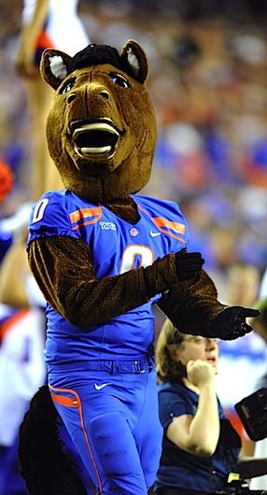
Will this College Mascot let you in?

Slide 10
Boise State University The Broncos Boise, Idaho Fall Students- Entering Class-2,214 HS GPA- 3.35 ACT- 22

Slide 11
Will this College Mascot let you in?

Slide 12
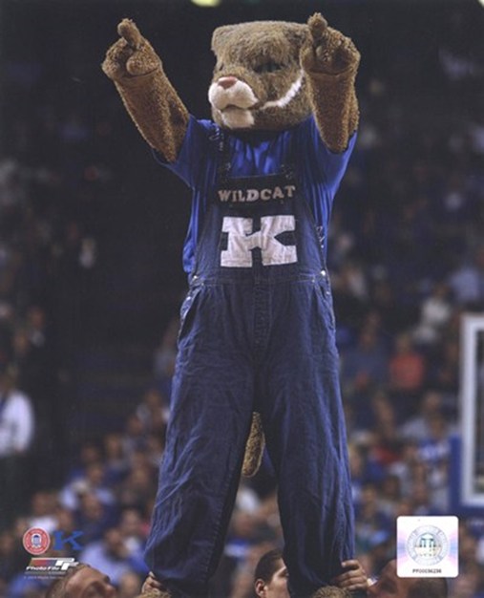
University of Kentucky
Wildcats
Lexington, Kentucky
Fall Students-
Entering Class- 4,328
HS GPA- 3.46
ACT- 22-28
SAT- 990-1250

Slide 13
Will this College Mascot let you in?

Slide 14
The Ohio State University
Buckeyes
Columbus, Ohio
Fall Students-
Entering Class- 6,549
HS GPA- 3.1
ACT- 28
SAT- 1235

Slide 15
Will this College Mascot let you in?

Slide 16
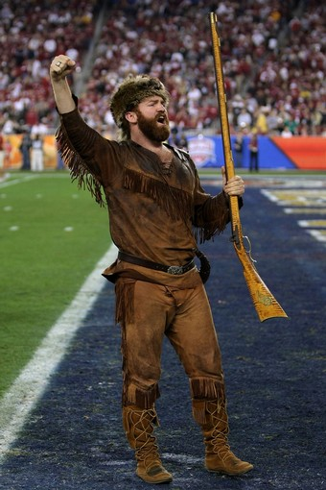
West Virginia University
The Mountaineers
Morgantown, West Virginia
Fall Students-
Entering Class- 5,011
HS GPA- 3.32
ACT- 21-26

Slide 17
Question
To get into college you are required to take three or more years of natural science classes (earth science, biology, chemistry, physic, etc.).
Notes:
TRUE
All college require three or more years of natural science classes. That said, you should try to take more science classes high school if you’re thinking about majoring in related field.

Slide 18
Question
Ninety percent of teens want to go to college, regardless of their income level.
Notes:
TRUE
Unfortunately, not all of these students have access to adult mentors who can guide them through the college preparation process.

Slide 19
Question
To get into college you are required to take three or more years of mathematics classes that are Algebra I and higher.
Notes:
TRUE
You must take at least 3 years of math at the Algebra I level of higher to prepare for college. If you take more advanced classes in high school, you may test out of basic college math.

Slide 20
Question
A lot of out-of-class activities will make up for poor grades.
Notes:
FALSE
While colleges consider out-of-class activities such as athletics, student government, and music when they review an application, they look at your academic performance first.

Slide 21
Question
The ACT was designed to assess your ability to complete college-level work.
Notes:
TRUE
While the SAT tests the skills you learned in math, writing, and reading, the ACT tests your knowledge of those subjects and more. The questions are not unlike questions that would appear on a college test.

Slide 22
Question
Large universities have greater diversity.
Notes:
FALSE
This is true if “greater” diversity: simply means heaving greater number of African Americans, Hispanic American, Asian Americans, Native American and international students. Unfortunately, the size and nature of a large university often mean that there is little interaction among those various ethnic and racial groups.

Slide 23
Question
It’s better to take a challenging course than get good grade.
Notes:
TRUE
When you have even some success in advanced or accelerated courses, it indicates to a college that you can handle challenging courses, like those you will find in college.

Slide 24
Question
To get into college you are required to take three or more years of social science classes (history, economics, geography, civics, psychology, etc.).
Notes:
TRUE
All colleges require three or more years of social science classes. That said, you should try to take more social science classes in high school if you’re thinking about majoring in a related field.

Slide 25
Question
I don’t need to decide on my major before I can choose a college.
Notes:
TRUE
College is your time to explore. In most cases, you can choose a major in your sophomore year and still complete your degree in four years.

Slide 26
Question
Some of the best colleges out there are ones I’ve never heard of.
Notes:
TRUE
Some of the nation’s finest colleges don’t play big-time athletics. Judge a college on its own merits, not on name recognition.

Slide 27
Question
If I apply for a loan, I have to take it.
Notes:
FALSE
Families are not obligated to accept a low-interest loan if it is awarded to them. Even if you are awarded a loan, you can turn it down and try to find money elsewhere.

Slide 28
“Be a Pain”
Spell out 4 words correctly

Slide 29
“Be a Pain”
Teacher
Coach
Parent
Sibling

Slide 30
Question
The best time to visit college is before I am admitted.
Notes:
TRUE
Many students find that none of the colleges to which they admitted “felt” right when they visited. If possible, visit before you apply and again after you have been admitted.

Slide 31
Question
You should choose a major that will guarantee you’ll earn a lot of money after college.
Notes:
FALSE
Even if you earn a lot of money, you probably won’t last long if you don’t have interest in the industry. Think seriously about what your favorite subjects are and what you do in your spare time, and then pick a related major.

Slide 32
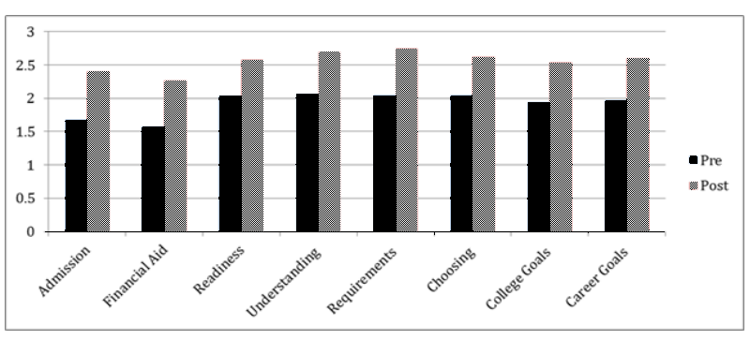
Survey Results
3022 students in 9 counties
3 Point Likert Scale
Self-reported knowledge with scores ranging from .93 –1.13 and a mean increase of 1.00
Mean score for usefulness of the program was 2.58

Slide 33
Conclusion
Understanding the College Admission Office and Financial Aid showed the largest impact.
The areas showing the least amount of change were Choosing a College and Career Goal Setting. These two categories scored the highest in knowledge in the pre-assessment.
Advantage - put youth in a group setting to explore college and careers vs. an individual setting with a counselor.
Disadvantage - not having specific schools, programs, or alternatives to traditional college settings present in discussion.

Slide 34
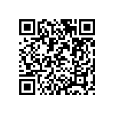
Materials and handouts
go.osu.edu/collegeready
hedrick.10@osu.edu
dick.7@osu.edu
light.42@osu.edu

