Slide 1
Institutionalizing Service-Learning at Ohio State
Ola Ahlqvist & Harmony Cox
The Service-Learning Initiative

Slide 2


Our Community Context
Columbus
State capital of Ohio, largest city in the state and 15th largest city in the United States
“America’s Test Market”- diverse cross-section of populations, neighborhoods and culture
Healthy culture of volunteering and service- ranked 8th in the nation for Young Adult Volunteerism (aged 18-24)
The Ohio State University
60k students (grad and undergrad), 56k at Columbus campus
30k employees (faculty and staff), Ohio’s 5th largest overall employer
Service is HUGE at Ohio State- over 25k students participated in a service activity in 2011-2012
Over 12k courses offered through 14 colleges

Slide 3

Why Service-Learning at Ohio State?
“Bringing the skills and caring of Ohio State’s faculty, staff, and students to bear on the needs of the community is one of the proudest parts of our land-grant mission. What is required of us is the will to work together to improve lives and to enrich communities throughout Ohio and well beyond.”
– E. Gordon Gee
Notes:
Pause for a moment and think about what the foundational principles, mission of your institution is. Anything that strikes a chord?

Slide 4

Some history of
The Service-Learning Initiative
Began in 1999 as the “Service-Learning Scholars Roundtable”
Created by faculty to promote service-learning and civic engagement at Ohio State
Leveraged funding from AmeriCorps and other sources to support institutionalization of service-learning
Became a staffed function within the Office of Outreach and Engagement in 2006
Created “s-designation” for service-learning course offerings in 2008

Slide 5
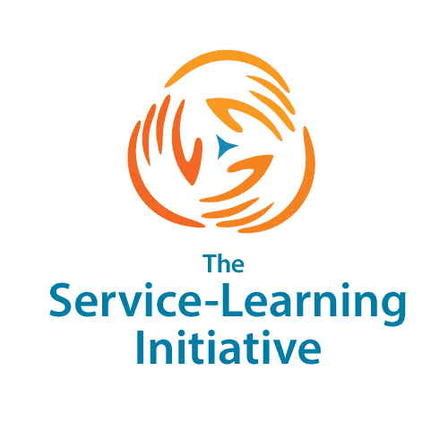
What does the S-LI Do Today?
Newly affiliated with the Office of Undergraduate Education
1.5 paid staff positions
Focus areas include:
  Grants and resources
  Workshops and other events
  One-on-one consultation
  Course listing and promotion
  Official course approval of service-learning courses
  Sharing information via our mailing list and other channels

Slide 6
What has the Current S-LI accomplished?
In 2012-2013:
  Nearly 3,000 Ohio State students participated in an identified service-learning course
  40 courses are officially recognized as service-learning course offerings at Ohio State
  Over 100 staff or faculty members participated in events sponsored/organized by the S-LI
  S-LI activities have led to campus-wide disbursal of $40k to support service and civic engagement at Ohio State
    Service-Learning Course Design Institute 14 particpants
  6 faculty, staff and student awards, campus wide RFP
  Semester conversion and General Education curriculum approval process
  How do two people accomplish all of this in one academic year?

Slide 7
Success through partnership
S-LI
Undergraduate Education
University Center for the Advancement of Teaching
Student Life
Advisors
Outreach and Engagement
College of Arts and Sciences

Slide 8
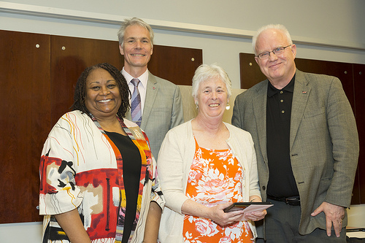
Outreach And Engagement Recognition Awards
Annual opportunity to recognize excellence in service at Ohio State
In 2013, S-LI collaborated with Outreach and Engagement and the Office of International Affairs to integrate awards into Patterson Lecture events
11 awards were presented to faculty, staff, students, student organizations, and community partners in various categories
University Outreach and Engagement Award winner The Young Scholars Program (YSP) was Ohio State’s National Magrath Award nominee; is one of four finalists nationwide

Slide 9
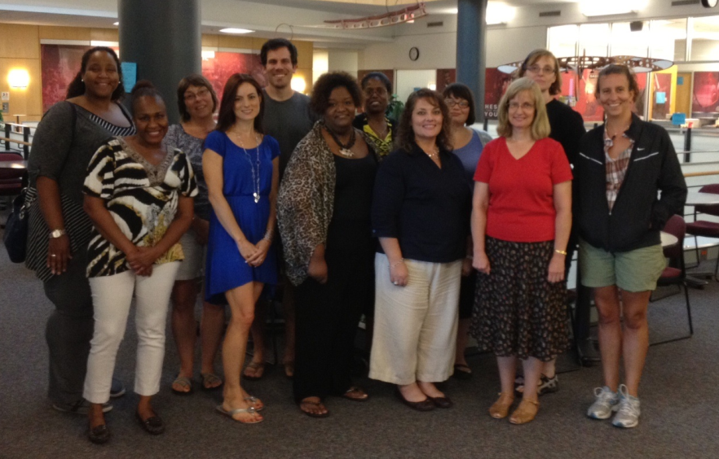
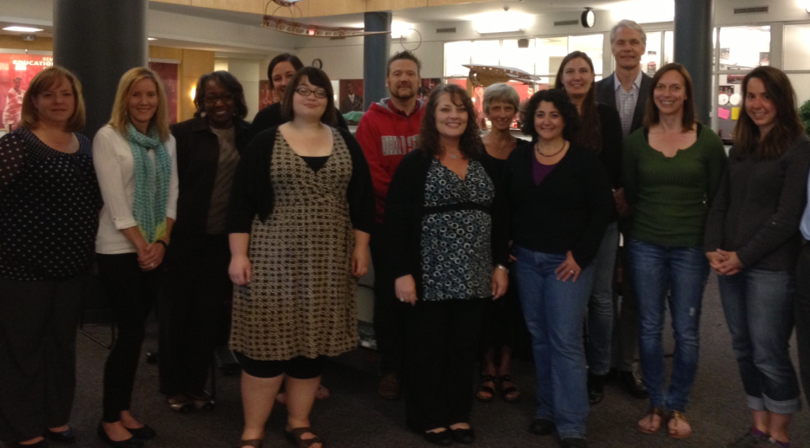
Service-Learning Grants Program
Presented with support from the Office of Undergraduate Education and the Office of Outreach and Engagement
Supports creation and enrichment of service-learning courses
In 2013, 13 courses received nearly $40,000 in grant funding
Funding is accompanied by Service-Learning Course Design Institute (via UCAT) and grantee Learning Community

Slide 10

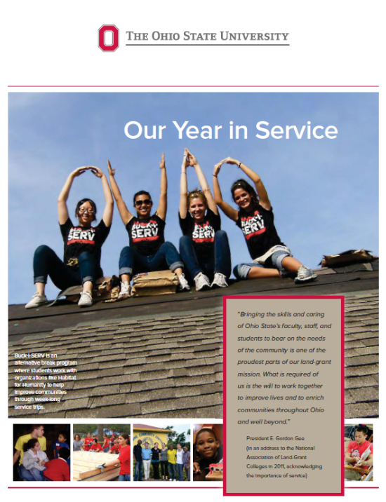
The President’s Higher Education Community Service Honor Roll
Annual recognition of higher-education institutions that demonstrate meaningful community impact
General service data report and opportunity to highlight 6 narratives for exemplary service projects
Ohio State has placed annually since 2006
The data collected is institutional data: everyone should be represented, access it and use it for fundraising, publicity,...
Institution-wide reporting helps us break our of our “silos”

Slide 11
GE Open Option for Service-Learning Courses
With the conversion to semesters, the University added a General Education Open Option :
  Education Abroad
  Cross-disciplinary seminars
  Service-Learning
  Other GE approved courses
Goal and objectives for the Service-Learning Open Option:
“Students gain and apply academic knowledge through civic engagement with communities.”
Students make connections between concepts and skills learned in an academic setting and community-based work.
Students demonstrate an understanding of the issues, resources, assets, and cultures of the community in which they are working.
Students evaluate the impacts of the service learning activity.
Notes:
BS in Mechanical engineering, BA in Journalism often larger programs and associated with accreditation.

Slide 12
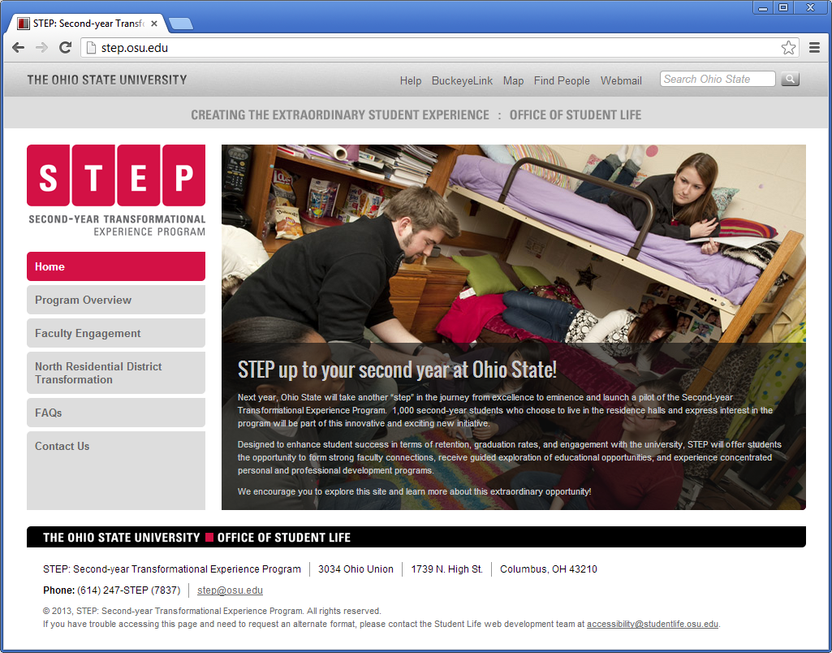

Slide 13
next big challenge - STep
STEP (Second-Year Transformational Experience Program)
Introduce second-year students to a year-long “transformative” high-impact practices such as service-learning.
Leadership from Office of Academic Affairs and Office of Student Life
S-LI participates with other offices to create programming for 1,000 student pilot in 2013-2014
Could have major external impact.

Slide 14
The challenge
The S-LI needs to scale programming dramatically for full implementation in 2017
Instructors need to manage new and existing relationships with community members to support new programming
Both need to invite community agencies to be true partners
Both have to find a way to balance these needs with higher-level university expectations for STEP

Slide 15
STEp community partner workgroup
“The workgroup intends to create an open dialogue between area nonprofits and the Service‐Learning Initiative to guide us through the creation of our programming for STEP, with a long‐term vision of improving our support and understanding of community/university partnerships.”
Composed of S-LI, central Ohio nonprofit representatives
Purpose is to guide creation of STEP programming and ensure that community voices are included in planning
Overarching goal is to work towards models and best practices that can be used on institutional level

Slide 16

Questions? Comments?
The Service-Learning Initiative at the Ohio State University
http://service-learning.osu.edu
Ola Ahlqvist
Director
ahlqvist.1@osu.edu
Harmony Cox
Program Coordinator
hcox@esue.ohio-state.edu

