Slide 1
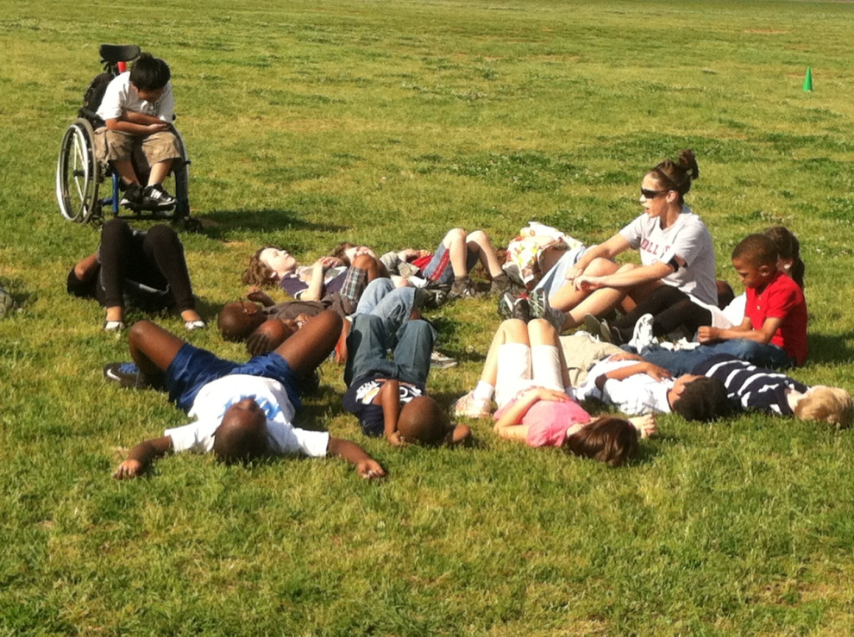
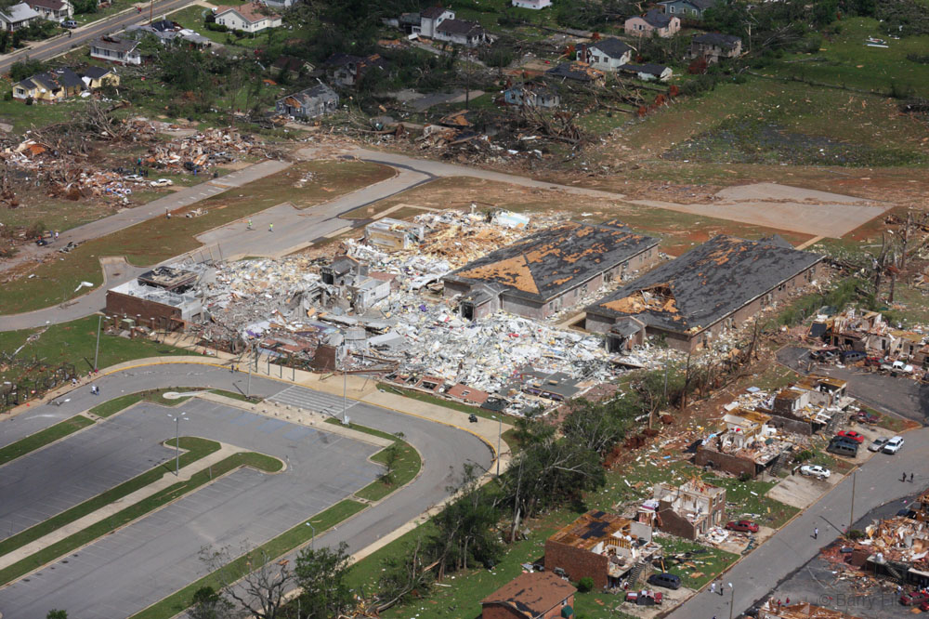
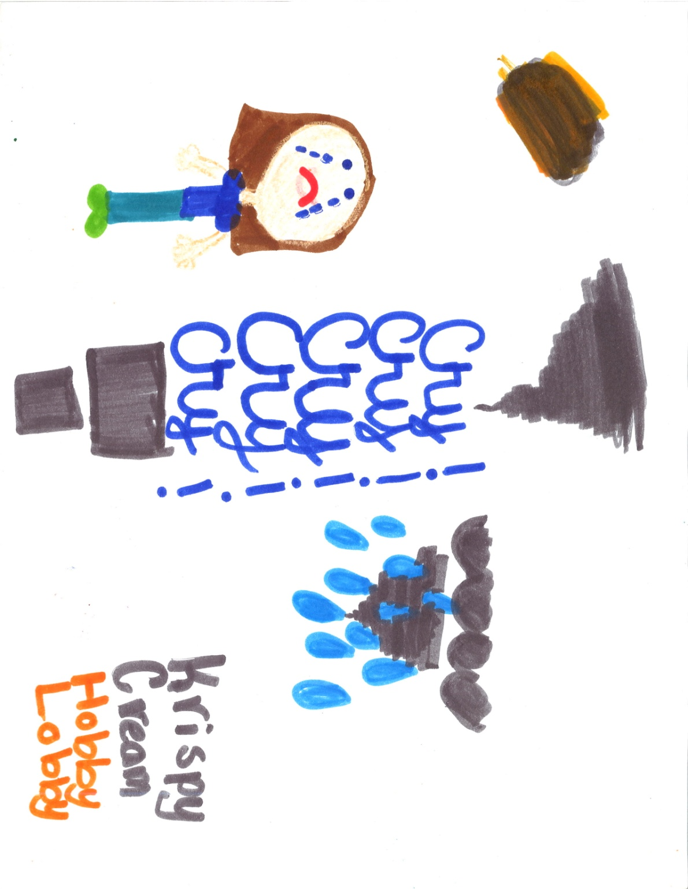
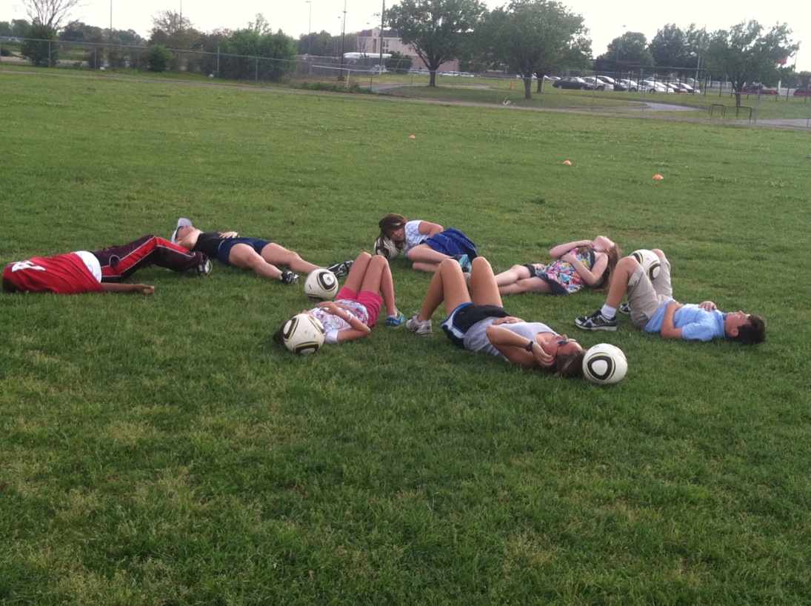
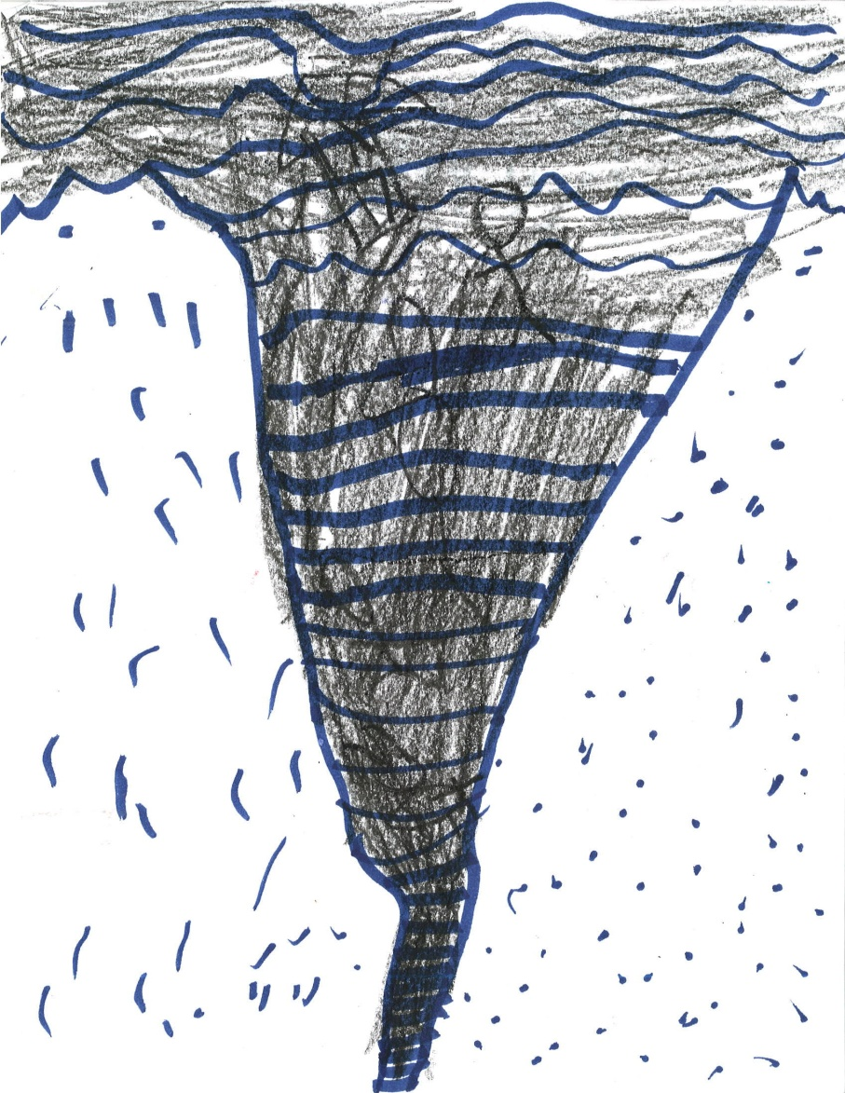
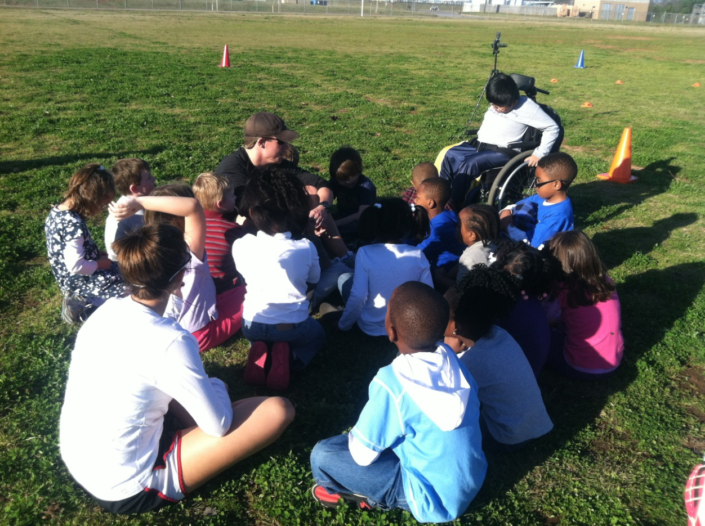
Physical activity and stress reduction in children
affected by a natural disaster
Zachary Wahl-Alexander, Oleg A. Sinelnikov
Matthew D. Curtner-Smith, Mary Elizabeth Curtner-Smith
Introduction
Program Description
On April 27th, 2011 a devastating series of tornadoes tore through the southeast United States, killing over 300 people, and producing over a billion dollars in damages (NOAA, 2012). After traumatic events, children who are directly or indirectly involved in the event show evidence of a number of intense emotional reactions.
The program included somatic stress reducing, psychological stress reducing, and art therapy techniques as well as group sharing sessions, all of which were integrated within developmentally appropriate physical activity.
Art Therapy
In the program, students were given the opportunity to express their feelings, emotions and fears during art therapy sessions which were held every other lesson. Students were provided with a drawing pad, a choice of drawing mediums and ample time to complete each drawing. . Each session was intended to artistically allow students to express their feelings and emotions with regards to the traumatic events and create psychological mechanisms for managing stress.
Physical Activity
A developmentally appropriate soccer curriculum was created as the foundation for the physical activity aspect of the recovery program. All sessions consisted of two different periods of physical activity, each lasting 20 minutes. Instructors focused on developing technique and solving tactical problems within drills and modified games.
Somatic Stress Reducing Technique: Positive Self-Talk
Positive self-talk has been identified by children as the most frequently reported cognitive coping strategy in stressful situations. In this program, the concept was first explained and then scripted positive self-talk examples were provided for each child. Later, students were encouraged to create their own statements in addition to those provided by instructors.
For example, shock and denial are typical responses, especially shortly after an event. Most psychologists agree that both mechanisms (shock and denial) serve as normal protective reactions for individuals. However, after the initial shock wears off, there are a number of other responses that typically occur: disbelief, fear/sadness, helplessness and guilt (Myers, 1994).
Physical activity has often been recommended as one strategy for reducing stress in children who are dealing with the aftermath of a traumatic event (Brown, 1991; Dunn, Trivedi, & O’Neal, 2001; McNamara, 2000).
Physiological Stress Reducing Technique: Deep Breathing
deep breathing and muscle relaxation
intentionally and specifically taught
appropriate breathing sequence
the goal - to perform each technique on own
Group Sharing Sessions
Students in the program had the opportunity to share their experiences from the storm in a safe environment. Once a week students got in small groups and shared experiences, feelings and emotions. Additionally, children were given the opportunity to share their art work at this time.
Purpose of the Program
Discussion
To develop and implement a curriculum to: (a) reduce students’ current stress and anxiety levels, (b) provide students with developmentally appropriate physical activity, (c) provide students with a platform for shared experiences, and (d) provide students with ways to cope with traumatic events.
This presentation describes a variety of tools for teachers and parents to aid in students’ recovery from traumatic events.
The stress-reducing and coping techniques described are not only useful after a natural disaster but can be used after other stressful events in students’ lives (e.g., parent divorce, family and/or friend illness or death).
A combination of somatic, physiological and art therapy techniques in the program created a unique environment for the students that were previously unseen in the experiences in physical activity settings.
Participants
Forty students (K-5) participated in the after-school program which was administered by the Department of Kinesiology at the University of Alabama. The three-month curriculum conducted twice a week was carried out within the structure of an afterschool program at this neighboring elementary school in Tuscaloosa.

