Slide 1
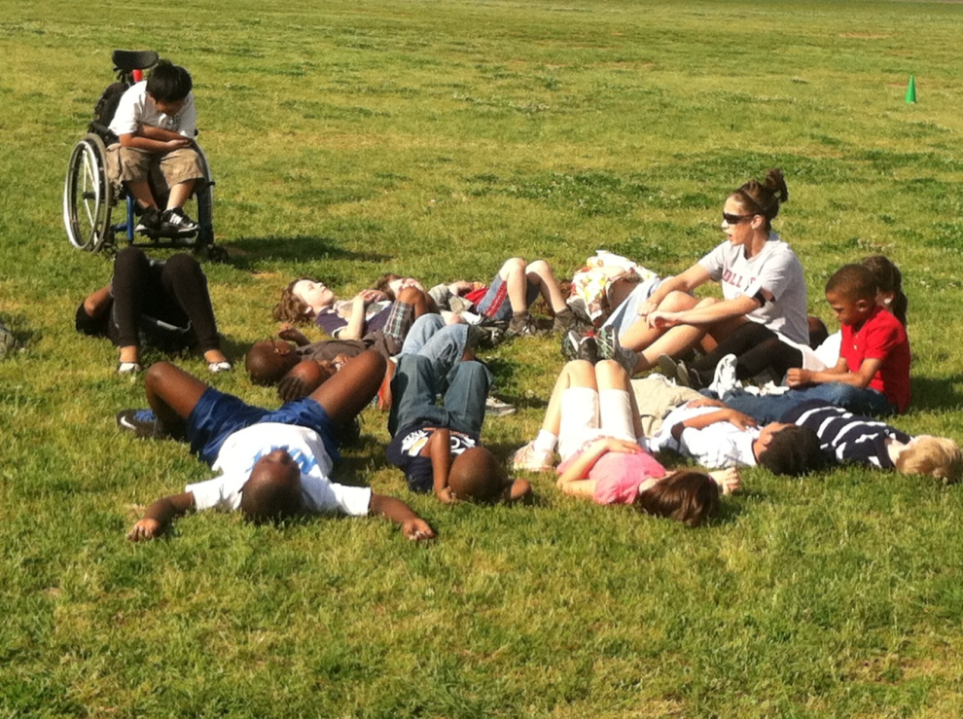
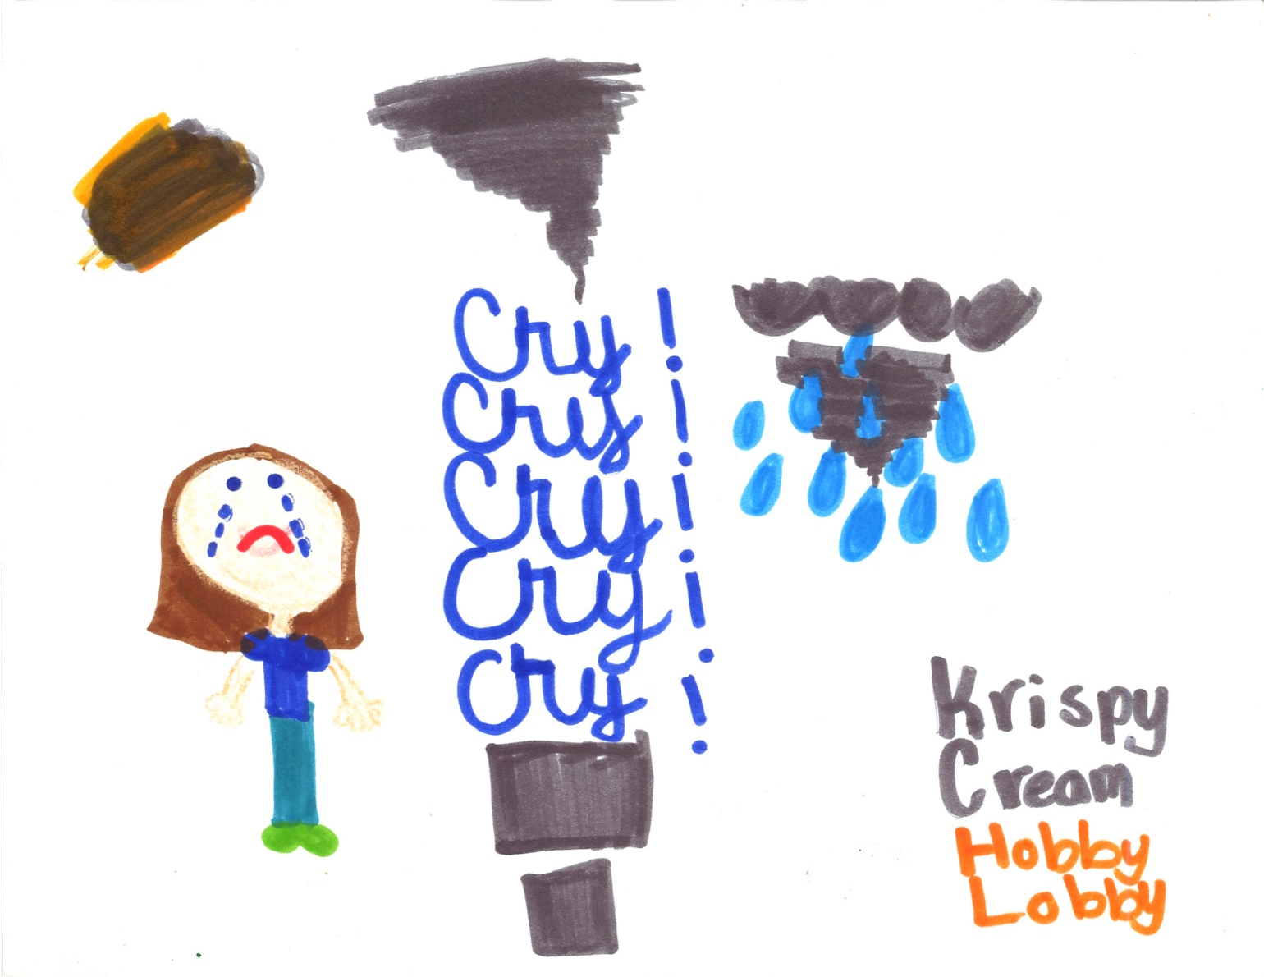
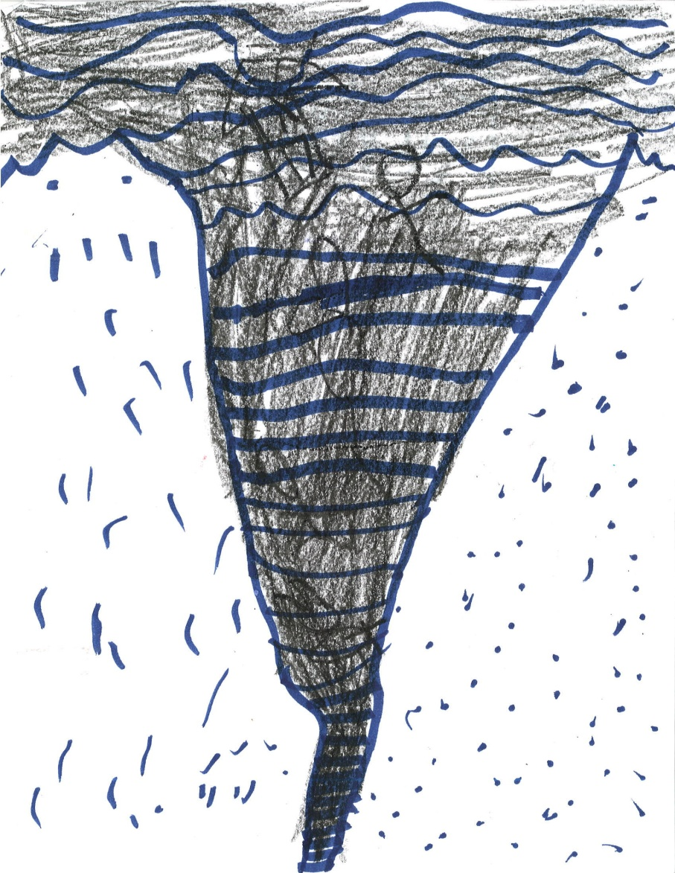
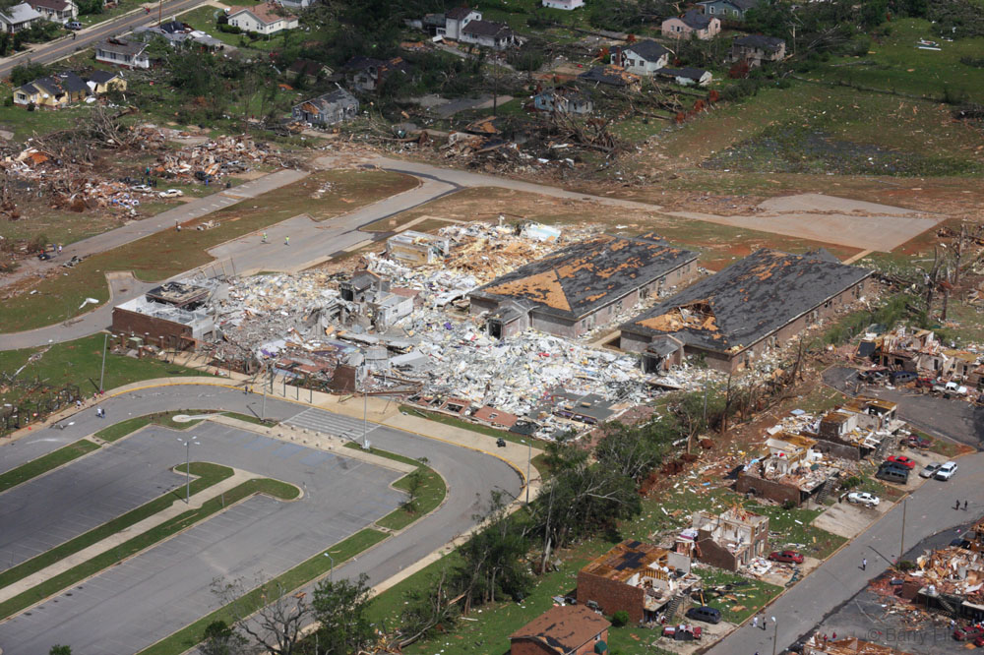
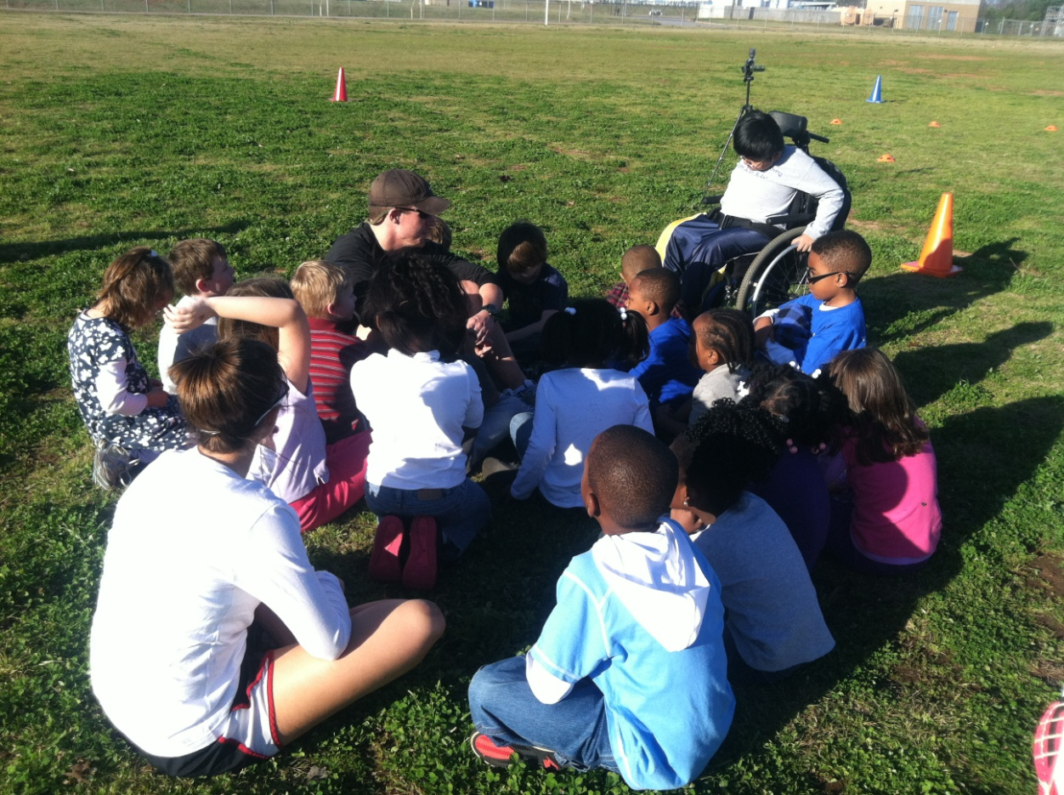
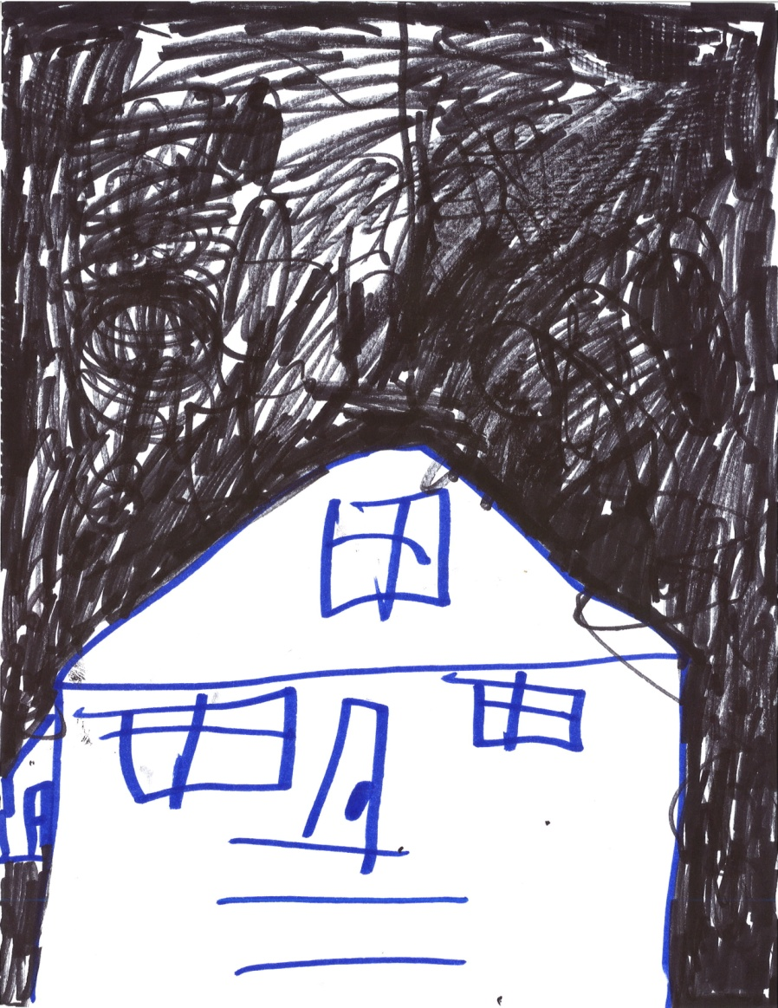
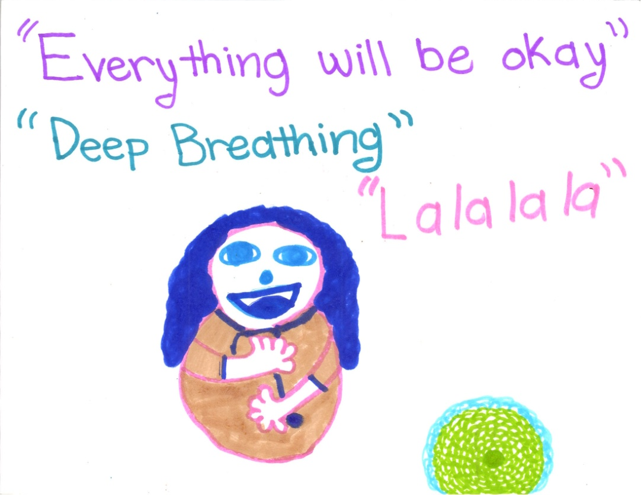
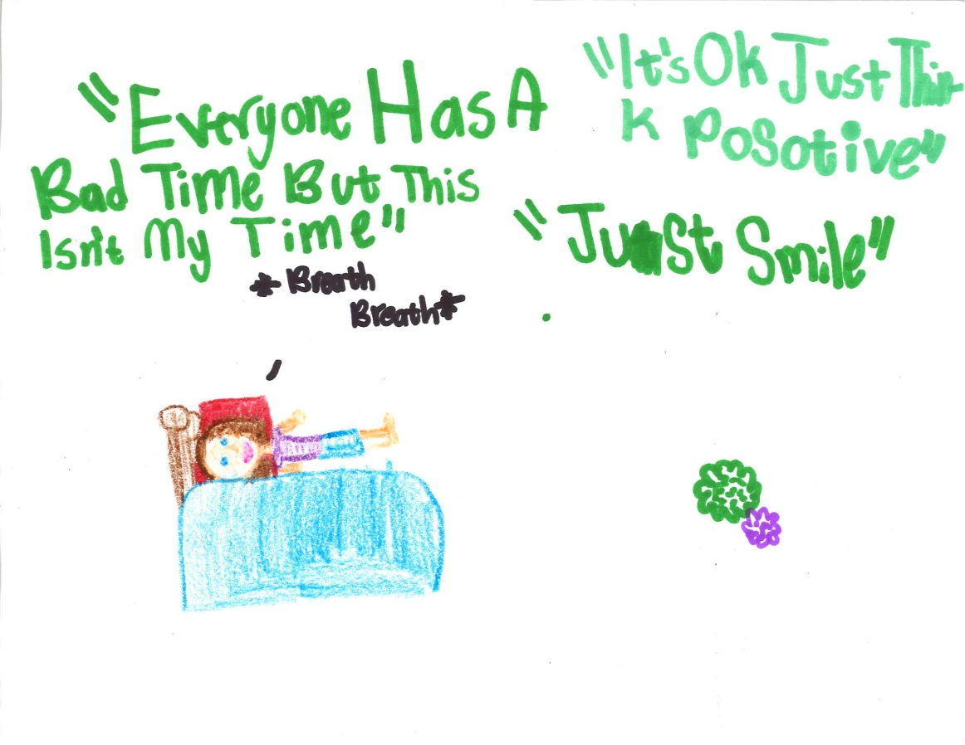
Amalgamation of Art Therapy and Physical Activity
Zachary Wahl-Alexander & Oleg A. Sinelnikov
Background
Program Layout
On April 27th, 2011 a devastating series of tornadoes ripped through the southeast United States, killing over 300 people, and producing over a billion dollars in damages (NOAA, 2012). After traumatic events, children who are directly or indirectly involved in the event show evidence of a number of intense emotional reactions.
The program included somatic stress reducing, psychological stress reducing, and art therapy techniques as well as group sharing sessions, all of which were integrated within developmentally appropriate physical activity.
The art therapy sessions were specifically allocated in between periods of physical activity.
The actual structure of each session consisted of the initial period of physical activity (20 min.) followed by an art therapy session (20 min.) and 20 more minutes of physical activity
For example, shock and denial are typical responses to natural disasters, especially shortly after an event. However, after the initial shock wears off, there are a number of other responses that typically occur: disbelief, fear/sadness, helplessness and guilt (Myers, 1994).
Physical Activity Art Therapy
Discussion
Developmentally appropriate soccer was the foundation for the physical activity aspect of the recovery program
Each session was taught by Graduate Teaching Assistants from the University of Alabama Kinesiology Department.
All sessions consisted of two different periods of physical activity, each lasting 20 minutes
As the program progressed, instructors focused more on assisting with tactics using indirect teaching styles while the children participated in these games
Art therapy has been shown to diminish trauma symptoms and anxiety in both children and adults
Students were provided with a drawing pad, a choice of drawing mediums (different colored crayons, markers, and pencils) and ample time to complete each drawing.
In the program, instructors initiated each art therapy session with an intended outcome designed to focus student creativity.
Each session was intended to artistically allow students to express their feelings and emotions with regards to the traumatic events and create psychological mechanisms for managing stress.
This program suggests that providing students with developmentally appropriate physical activity and integrating art therapy can improve stress and anxiety levels in elementary aged children.
The combination of art therapy techniques and physical activity in this program created a unique environment for the students that were previously unseen in the experiences in physical activity settings.
Art therapy, specifically drawings, has been shown to help children to express emotions, feelings, and manage their emotional state following a traumatic event. Therefore, the programmatic innovation of our outreach efforts was to integrate art therapy within a developmentally appropriate physical activity curriculum.
Purpose
The purpose of the presentation is to provide a descriptive account of an outreach physical activity and art therapy program for elementary aged students affected by April 27, 2011 tornadoes.
References
Participants
National Oceanic and Atmospheric Administration (NOAA), National Climatic Data Center. (2012). State of the climate tornadoes annual 2011.
Myers, D. (1994). Psychological recovery from disaster: Key concepts for delivery of mental health services. National Center for Post-Traumatic Stress Disorder Clinical Quarterly, 4, 1-5.
Forty students (K-5) participated in the after-school program which was administered by the Department of Kinesiology at the University of Alabama. The three-month curriculum conducted twice a week was carried out within a structure of an afterschool program at a neighboring elementary school in Tuscaloosa.

