Slide 1
The Pennsylvania State University Service Learning- Engaged Scholarship Task Force
Sponsored by
Interim Provost
Vice President, Student Affairs
Vice President, Outreach
Presented by
Careen Yarnal and Janet Conner

Slide 2
Priorities for Excellence, The Penn State Strategic Plan, 2009-10 through 2013-14
“A considerable body of research indicates that students who are more engaged in public scholarship and service learning are more successful in their college experiences and upon graduation are more likely to be engaged citizens in their communities...the University must provide more opportunities to engage... undergraduate students”

Slide 3
Task Force Charge
Define what service learning and engaged scholarship mean for Penn State;
Benchmark with other higher education institutions nationwide;
Identify what is currently done well at Penn State, consider scalability;
Recommend alternative University strategy for coordination of service-learning opportunities across Penn State.

Slide 4
Subcommittees Defined by Charge
Membership
Define
Associate VP, Student Affairs
Director of Student Engagement, World Campus
Extension
Director of Academic Affairs, Penn State Harrisburg
Graduate Student
Benchmark
Faculty Member
Undergraduate Research
Public Broadcasting
Shaver’s Creek Environmental Center
Identify
Faculty member
Small Business Development Center
Schreyer Institute for Teaching Excellence
College of Science Administrator
Faculty and Curriculum
Associate VP, Undergraduate Education
Associate VP, Student Affairs
Director of Academic Affairs, World Campus

Slide 5
Task Force Process (1)
Explored other models
Conducted literature review
Benchmarked other programs and interviewed directors
Developed survey instrument to identify current offerings
Presented to:
Academic Council on Undergraduate Education
Council on Engagement (Council for Engaged Scholarship)

Slide 6
Task Force Process (2)
Invited faculty doing engaged teaching and engaged research to present and meet with Task Force
Conducted broader faculty focus group to identify institutional barriers
Met with Development /Alumni Relations
Met with student leaders
Met with community connectors: internal and external

Slide 7
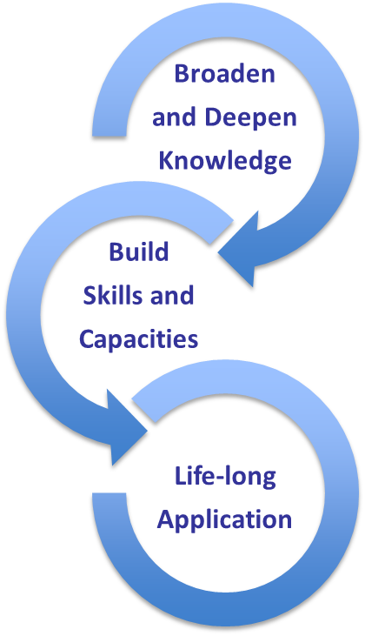
Engaged Scholarship in Action

Slide 8
High
community engagement
Abstract Thinking
Applied Thinking
Problem Finding
Problem Solving
Engaged Scholarship Continuum Model
Low community
engagement
Student Success
Volunteering
Service Learning
Engaged Scholarship

Slide 9
Report Recommendations
Establish Center for Engaged Scholarship
Reinforce links with Undergraduate Education, Outreach, and Student Affairs, reflects unique, powerful triad
Establish home in Undergraduate Education, reflects commitment to academics

Slide 10
Steps for 2012-2013(1)
Build university-wide awareness and support.
Discuss with and integrate input from:
Deans
Chancellors
Center and Initiative Directors
World Campus
Community Connectors
Students
Development and Alumni Relations

Slide 11
Steps for 2012-2013 (2)
Establish Council on Engaged Scholarship
Integrate into University Assessment Plan
Complete Senate Report
Establish other funding sources
Present to President’s Council
Present to Board of Trustees

