Slide 1
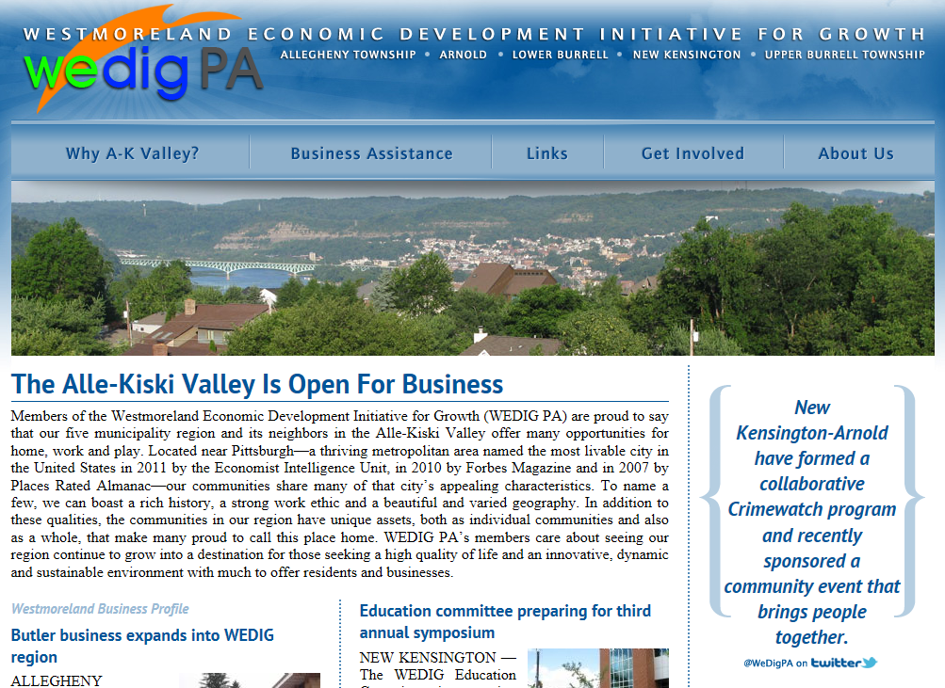
Partnering, Inspiring, and Changing the Region: Promoting Student Engagement
Richard J. Harnish and K. Robert Bridges
Abstract
We describe the different service-learning projects conducted with our community partners which have transpired over seven years. Students reported high satisfaction with the course as compared to a similar course that does not have a service-learning component.
Introduction
What is WEDIG?
WEDIG is a 501(c)3 corporation comprised of community partners, and faculty, staff and students of the Pennsylvania State University, New Kensington. WEDIG takes a regional approach to solve common issues.
Because of the campus' involvement in WEDIG, community partners often approached the university and asked for assistance in various projects.
The Course
In an applied social psychology course we teach, service-learning projects were conducted with our community partners which involved the collection, analysis and reporting of data.
The Projects
Projects have included:
Collecting and analyzing data for comprehensive plans;
Understanding stakeholders needs for a Weed and Seed program;
Conducting a feasibility study for building a minor league baseball park;
Performing an economic indicators survey of the region,
Surveying local businesses to identify gaps in skills among graduates of the university, and
Coordinating and hosting regional economic development planning.
Evaluation
Measures
We used two dependent measures to evaluate the effectiveness of using service-learning in our course: the university’s Student Ratings of Teaching Effectiveness (SRTE) and final course grades and compared to another applied social psychology course that did not use service-learning.
Because the university only considers two of the SRTE measures as critical to faculty evaluation, comparison data is only available for students’ perceptions of overall quality of the course and overall quality of the instructor.
Results
Mean Student Ratings of Course and Instructor
Note. Ratings are based on a 1 to 7 scale where “1 = lowest rating” and “7 = highest rating.”
Mean Grades Earned in Course
Note. Grades are based on a five-point scale where “0 = F, 1 = D, 2 = C, 3 = B, 4 = A.”
Discussion
Those who were enrolled in a course that used service-learning projects evaluated the course and instructor higher than those who were enrolled in a course that did not use service-learning. Additionally, students earned higher final grades in the courses that used service-learning compared to course that did not use service-learning.
 | Course with Service-Learning | Course without Service-Learning | t-Test
Overall Quality of Course | M = 5.91, SD = .31 | M = 5.39, SD = .34 | t(8) = 2.40, p < .05, partial η² = .42
Overall Quality of Instructor | M = 6.11, SD = .32 | M = 5.57, SD = .47 | t(8) = 2.18, p = .06, partial η² = .37
 | Course with Service-Learning | Course without Service-Learning | t-Test
Final Grade | M = 3.86, SD = .18 | M = 3.05, SD = .08 | t(8) = 7.12, p < .001, partial η² = .86
For more information on the content of this poster, see Harnish, R. J., & Bridges, K. R. (in press). Promoting student engagement: Using community service-learning projects in undergraduate psychology. PRISM: A Journal of Regional Engagement.

