Slide 1
PARENTS ARE OUR PASSION: TWO PROGRAMS AND THEIR IMPACT
Sally L. Edwards, Director
Valerie A. Thorington, Assistant Director
Child Development Resources
The University of Alabama

Slide 2
A community service initiative of the
College of Human Environmental Sciences at The University of Alabama

Slide 3
How We Started
CCDBG Funding established by Congress in 1990 created new opportunities for states
Alabama, through the lead agency, the Department of Human Resources, made a progressive decision to develop Child Care Management Agencies --- grassroots organizations embedded in local communities.

Slide 4
Child Development Resources
CDR is unique in that most entities doing this work in Alabama – and indeed in other parts of the country – are free standing non-profits
Exceptional support from our Dean and UA administration who had a sense, even in the early 90s, of the impact and value of community engagement and how it could occur in a University setting

Slide 5
Child Development Resources (CDR) started in 1993, serving a multi-county area in west-central Alabama, with two primary purposes:
To develop relationships with parents and child care providers in order to provide child care resource and referral and to manage the child care subsidy program
To provide quality enhancement services to child care providers
All of the work at Child Development Resources is relationship oriented and strength based

Slide 6
Philosophical Framework
The National Strengthening Families Approach* seeks to mobilize partners communities and families to build family strengths promote optional development and reduce child abuse and neglect
*Center For The Study Of Law and Social Policy; Atlanta, Ga

Slide 7
Protective Factors
The following Protective Factors promote healthy outcomes, are key components of the Strengthening Families Approach, and are embedded throughout all CDR programming:
Parental resilience
Social connections
Knowledge of parenting and child development
Concrete support in times of need
Social and emotional competence of children

Slide 8
Touchpoints Model
Based in the work of Dr. T. Berry Brazelton, noted pediatrician and researcher at Harvard Medical School.
Provides skills and strategies with which practitioners can build alliances with parents of children age birth to three
“Touchpoints” are predictable times and events in development when a child’s behavior seems to fall apart and are often accompanied by parental frustration and self-doubt; these times are key opportunities for practitioners to “come alongside” to offer support and guidance
Operates from a set of “Parent Assumptions” and the “Principles of Touchpoints Practice”

Slide 9
Baby TALK
In 2000, the CDR made the decision to bring the Baby TALK model to Tuscaloosa.
Baby TALK (Teaching Activities for Learning and Knowledge) is a community effort designed to encourage parents in the nurture of their small children ages birth to three years.
New parents are provided with basic child development information and suggestions for developmentally appropriate activities.

Slide 10
A board book is given to parents to read aloud to their children, believing that reading aloud, more than any other single activity, will enhance the parent/child relationship as it encourages the child’s mental, social, and language development.
“Language, Literature and Love”

Slide 11
Baby TALK Rationale and Goals
Encourage parents in establishing a nurturing relationship with their children and to reinforce positive parenting practices
Share developmental information to parents in a timely and usable fashion in order to help them understand child behaviors
Suggest developmentally appropriate activities for parents to enjoy with their children in order to enhance the child’s development as well as the parent-child relationship

Slide 12
Service Delivery Model
Baby TALK is dedicated to a service delivery model which is:
readily accessible for families
allows parents to receive services meaningful for their needs rather than imposing an agenda which may not be as helpful to them
includes efforts to go where parents are already: to health care providers, to human service agencies, to neighborhoods, and to homes

Slide 13
Components
Hospital Visits
Baby TALK Times
Family Fun Events
Well Child / WIC Clinics
Prenatal Clinics
Developmental Newsletters
Supports Parenting Classes for Teen Parents
Warm Line

Slide 14
Baby TALK Data
Over 28,000 Baby TALK visits to new parents at two local hospitals
Over 850 parents and children participated in 22, eight week sessions of Baby TALK Times
93 Family Fun Night Events involved more than 1000 participants from 314 families
Over 51,000 visits to well-child clinic settings
Over 700 prenatal clinic visits at a local health care facility serving at risk families
Over 180,000 development newsletters have been mailed to families
Of the contacts with children at the various Baby TALK sites
47.0% were birth to 1 year
22.8% were 1 to 3 years
16.9% were 3 to 5 years
6.2% were 5 years to 7 years
6% were 7 years and older

Slide 15
Parent Information
Of the 20,000 Parent Information Forms received 18,517 parents shared marital and employment information:
52% married
40% never married
5% divorced
2% separated
< 1% widowed
38% employed full time
15.2% employed part time
35.8% not employed and not seeking employment
10.8% unemployed and seeking employment

Slide 16
Baby TALK Collaborations
272 volunteers have assisted with Baby TALK
Baby TALK collaborations have included:
The Children’s Trust Fund of Alabama
Junior League
United Way
Early Intervention
Community Foundation
Tuscaloosa’s One Place: A Family Resource Center
Exchange Club Foundation
Target Corporation
Dollar General Corporation
City and County Schools
University of Alabama Greek Organizations
Catholic Family Services
Alabama Career Center System
Alabama Civil Justice Foundation
Children’s Hands on Museum
Local Civic Organizations
Baby TALK sites: County Health Departments, Local Hospitals, Health Clinics, Early Head Start

Slide 17
PAL Alabama’s Parenting Assistance Line
PAL’s inception began with Mrs. Patsy Riley, Alabama’s Former First former First Lady, whose vision was was to provide parents the support they need to become more confident and successful in their role as parents.
The Parenting Assistance Line was launched in March 2007 to provide free information, support, and tools to parents and families across the state of Alabama

Slide 18
PAL Collaborations Have Included:
The University of Alabama
The Children’s Trust Fund of Alabama
Alabama Department of Human Resources
Alabama Department of Mental Health
The Office of Alabama’s First Lady
Wal-Mart Corporation

Slide 19
PAL has been fully operational for over five years
Over 12,000 calls have been received
Calls have been received from virtually every county in Alabama as well as 35 other states and Canada

Slide 20
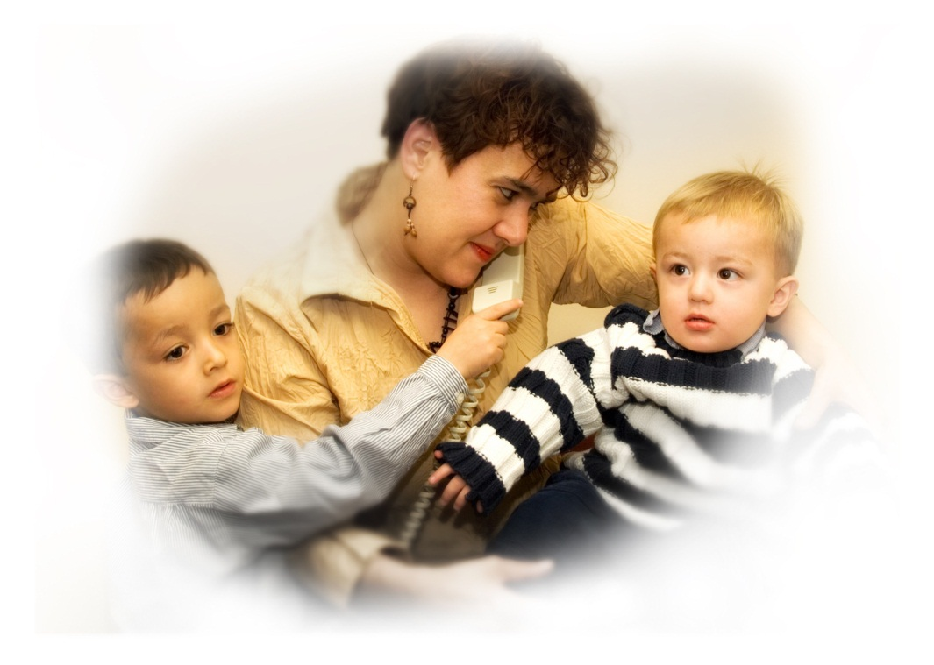
PAL is…
Free
Confidential
Anonymous
Available Monday through Friday
8 am to 8 pm

Slide 21
Calling PAL
When parents call the toll-free number they reach a Parent Resource Specialist who holds an undergraduate or graduate degree in Human Development and Family Studies (or closely related field) and has received additional specialized training.

Slide 22
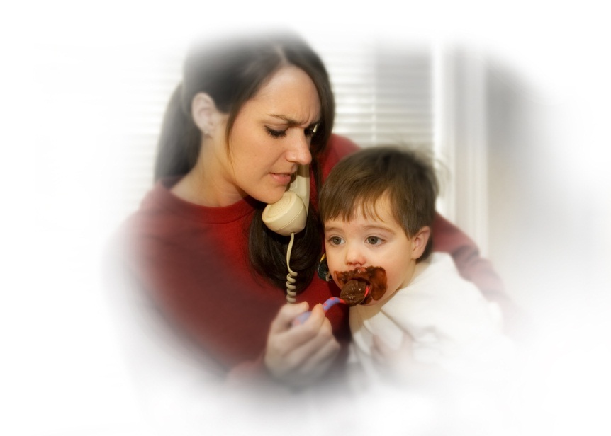
Sometimes parents just need to know they are “heard”
Because parents often call PAL when they are under great stress, frustrated or angry, Parent Resource Specialists practice:
Active listening
Validation
Concern
Compassion

Slide 23
Calls range from “typical” parenting issues: toilet training
sleeping
feeding
school-related issues
back-talk
TO . . . . . .

Slide 24
More serious situations:
children with disabilities
serious behavioral disorders
alcohol/ drug issues
cutting
pregnant teens
children from abusive situations

Slide 25
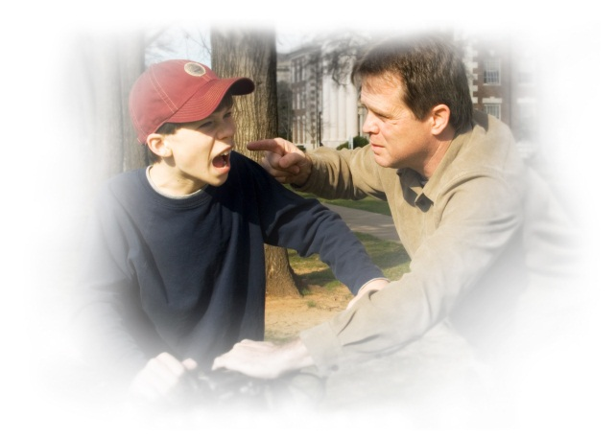
PAL operates from the belief that families benefit when parents understand…
Their child’s development
The skills needed for effective parenting

Slide 26
Parents can “talk it out” not “take it out” on their children.
When they have the opportunity to talk through their specific parenting situation or concern, parents feel…
Less Stressed
More capable and confident
Better able to cope

Slide 27
What We Know About PAL Calls
The vast majority of calls have been from Moms who have discussed parent support / parental stress issues.
PAL also receives calls from:
Grandparents
Other Family Members
Fathers
Professionals

Slide 28
Highest percentage of calls relate to preschoolers (3-6 years) and schoolagers (6-12 years)
Most calls are received . . .
Mondays & Wednesdays
10 AM – noon & 2 PM – 4 PM
Some escalation in May, June and August

Slide 29
56% of callers heard about PAL from family members, friends, professionals or the internet
Over 37% of callers heard about PAL through TV or radio
The website indicates over 62,000 visits from 164 countries on 6 continents

Slide 30
Primary Topics Callers Discuss:
Parental stress and support
Discipline and Guidance
Development
Health and Safety
Grief
Coping with life’s challenges

Slide 31
Quite frequently the ‘issue’ is not the issue.
The vast majority of our calls are multi-dimensional. Parents are dealing with several issues at once and the pressure becomes overwhelming.
Oftentimes during our conversations we find the caller starts off stating a matter-of-fact problem seemingly looking for a simple answer. As we continue, the caller will open up and the layers will be peeled back to reveal the core of the stress.

Slide 32
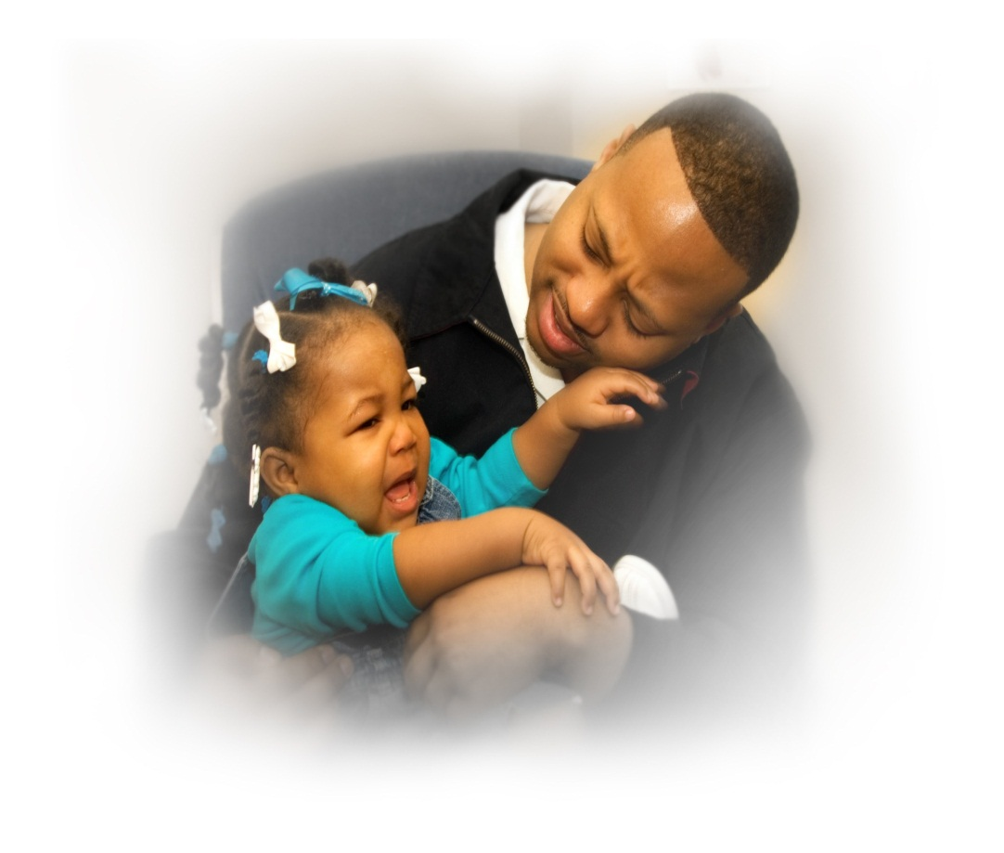
Even in the best circumstances, parenting can be tough,
and with today’s stresses and problems we all just need a little help…

Slide 33
PAL’s Website:
www.pal.ua.edu
PAL’s Phone Number: 1-866-962-3030

Slide 34
Student Involvement In These Initiatives
What opportunities are available for University students to be involved in scholarly outreach and engagement through these initiatives?
Researching and compiling relevant community resources for each of Alabama’s 67 counties for referral purposes
On-going monthly data collection of individual Parent Contact Forms
Researching relevant parenting topics determined by PAL staff used for the writing and printing of “Parent Tip Sheets” and for use on the PAL website
Researching current similar services throughout the United States
Assisting with exhibit opportunities and presentations at conferences / meetings
In collaboration with UA’s School of Social Work, a formal research project began in Fall of 2009; Literature review, development of research tool , all data entry and the beginning of data analysis has been student-driven under the direction of the PI of the project
Utilizes Undergraduate, Graduate, and Doctoral students

Slide 35
Student Involvement In These Initiatives
Internships
Direct interaction with parents and children at all Baby TALK sites
Compiling and entering data
Behind the scenes work necessary for program implementation
Research and develop materials for quarterly parent newsletters
Research and develop interactive parent / child activity kits
Assisted in the development of the community wide Parent Resource Library

Slide 36
Future Implications
Research possibilities
Opportunity to impact the quality of parent-child interactions via support and guidance
Opportunity to broadly influence both service delivery model and philosophical foundations in a way that best serves families
Potential for replication in additional communities, regions or states
Opportunity to share referral information with parents in order to strengthen the support network and safety net

Slide 37
The University of Alabama

