Slide 1
Alabama Entrepreneurial Research Network
aern.cba.ua.edu

Slide 2
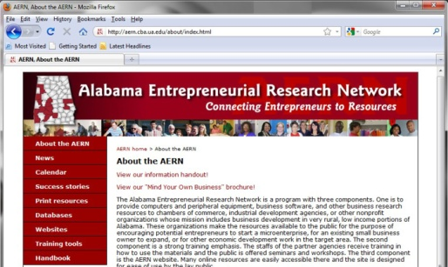
Inspiring Social And Economic Change through Engaged Community Partners
The University of Alabama
Culverhouse College of Commerce
AERN

Slide 3
AERN is a very replicable program
This model can work for business development in any rural area
AERN's community-based engagement is an excellent platform for scholarly achievement

Slide 4
AERN: How it started and what we do
Began as a program to enhance entrepreneurship in rural distressed areas
We form partnerships with nonprofits including chambers of commerce, economic development agencies, libraries, et.al.
We set up AERN centers to provide computers and business resources to our partners who, in turn, make them available to the public
We train entrepreneurs and our partners in the techniques of starting and expanding a business
We make online resources and business research available to the local communities

Slide 5
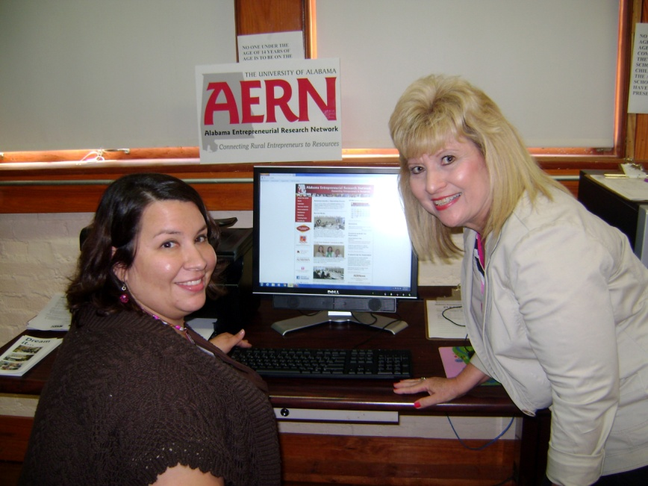
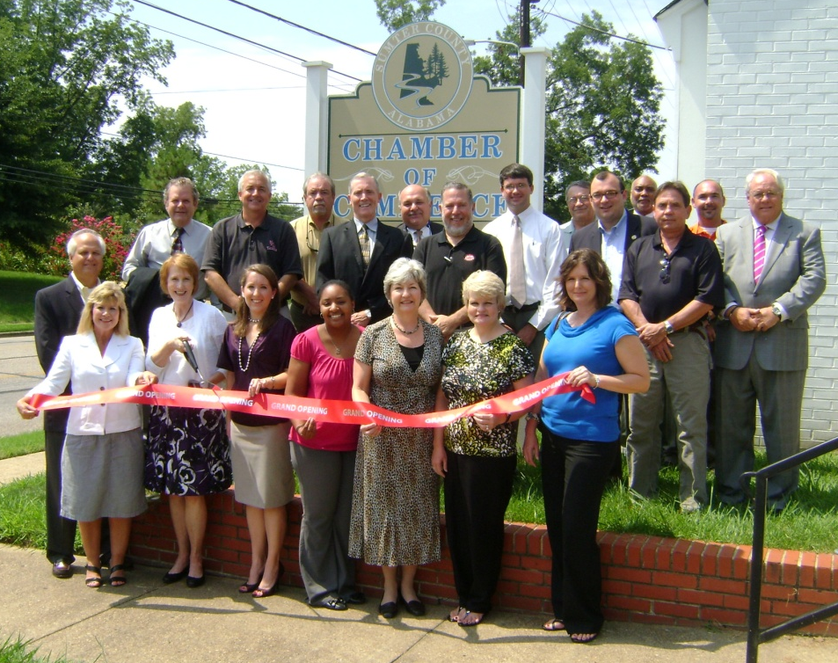

Slide 6
AERN: Forging a network for success

Slide 7
Support is vital
We write grants to provide funding
Governmental leaders support due to economic outcomes of the program
UA administration provides encouragement and funding
Partners contribute time, enthusiasm, office space and some funding

Slide 8
Collaboration is a key component
Intra-campus divisions share ideas and work together to deliver the program
Faculty/staff share their expertise in community seminars and workshops
Library staff extend business research to the rural communities
University research teams use this program as an avenue to the community

Slide 9
Education is enhanced
UA faculty become better scholars
UA students receive hands-on learning experiences in the community
Local entrepreneurs are educated on how to start, expand and be successful in business
Community leaders and chamber directors receive education on economic development

Slide 10
Engagement is an output
Rural communities “buy in” to the University’s expertise and value
Community stakeholders and University researchers develop relationships that facilitate trust
UA scientific knowledge is blended with community experiential knowledge
UA scholars are subjected to rural community diversity, allowing outcomes to be measured more accurately

Slide 11
Partnership
The University of Alabama
Rural Communities
Benefits
to UA
to Rural Communities

Slide 12
Benefits to UA
Faculty develops sensitivity to rural culture
Trust develops, imperative to research projects
Scholarly journal articles are written
Students have a medium for community-based learning

Slide 13
Benefits to rural communities
Economic change
Job creation
Industry recruitment
Capital investment
Improved prosperity
Social change
Leaders are developed
Quality of life is improved
Culture is enhanced and diversified

Slide 14
Keys to sustainability
UA administration must support
A proactive means of support must exist within the College of Commerce
Director of the program must understand the process and have a passion for its success
Partners must embrace the program and engage the business community
Partners’ boards of directors must believe in the program and appreciate the benefits
Must have financial support through monetary funding and in-kind contributions

