Slide 1
An Innovative Approach to Health Promotion in Nursing: A Collaborative Approach
Michele Montgomery, PhD, RN

Slide 2
Background
Major determinants of population health:
Lifestyle
Environmental factors
Genetic factors
Shift towards chronic illness and long-term disability
Nurse’s role:
Engage in health promotion and disease and injury prevention throughout lifespan
Notes:
Epidemiologic studies show that lifestyle, environmental, and genetic factors are major determinants of population health in areas of health, illness, disease, disability, and mortality.
As the health of the population shifts towards chronic illnesses and long-term disability, acute care and disease-based episodic interventions alone are inadequate for improving health (Allan et al., 2004; Allan, Stanley, Crabtree, Werner, & Swenson, 2005).
Nurses must be adequately prepared to engage in activities that focus on health promotion and disease and injury prevention throughout the lifespan, and, therefore, it is essential that undergraduate nursing programs provide their students with health promotion clinical experiences.

Slide 3
Health Promotion and Nursing
Association of Community Health Nurse Educators
Focus practice at community level
Affordable Care Act
37 provisions to enhance health through healthy lifestyles
National Council Licensure Examination (NCLEX-RN)
6-12% of content focused on health promotion
American Association of Colleges of Nursing
Health promotion essential
Notes:
The Association of Community Health Nurse Educators’ (2010) recent report suggests that it is time to focus on practice where there is a community level population focus and where support is available to develop essential nursing practice competencies including partnership skills.
Additionally, new federal legislation enacted in early 2010 positions health promotion as an integral part of health care reform. The Affordable Care Act includes 37 separate provisions to enhance health through healthy lifestyles. Collectively, these provisions have the potential to make health promotion programs available to the majority of the American public.
Furthermore, health promotion serves as critical content in nursing education comprising between 6-12% of the National Council Licensure (NCLEX-RN) Examination. The health promotion category of this exam requires nursing graduates to have the knowledge to incorporate prevention and/or early detection of health problems and strategies, which will help clients and their family/significant others to achieve optimal health.
In addition, the AACN includes an essential about health promotion which states, “Health promotion, disease, and injury prevention across the lifespan are essential elements of baccalaureate nursing practice at the individual and population levels. These concepts are necessary to improve population health (AACN, 2008).” The inclusion of health promotion on the NCLEX-RN examination and as an essential for nursing curriculum according to the AACN reinforces the concept of health promotion as a core component of the nursing profession.

Slide 4
Health Promotion at a University
Faculty and staff benefit from health promotion programs
Unique opportunity to implement health promotion programs
Recreation and fitness resources
Availability of health professionals

Slide 5
Health Promotion and Nursing Students
Nursing students
effectively provide health promotion programs
Increase employee knowledge, positive health behavior changes, and morale
UA Capstone College of Nursing (CCN) Senior-level students
Community Health Nursing Clinical Rotation
Provide health screenings and health advising for UA employees at WellBama events.
Notes:
Recent research indicates that health promotion programs provided by university nursing students can be effective (Carter & Gaskins, 2005; Hall-Barrow, Hodges & Brown, 2001). One study on employee health promotion found that screening and health coaching provided by nursing students in a small industry setting increased employee knowledge, positive health behavior changes, and morale (Carter & Gaskins, 2005).
To prepare baccalaureate nursing students, the UA College of Nursing (UACN) provides an intensive health promotion focus at the senior level in the community health nursing (rotation/experience/course). The UACN students engage in health promotion activities through the training and delivery of health screenings with accompanying health advising sessions for The University of Alabama faculty and staff in the University’s signature health and wellness program, entitled WellBama.

Slide 6
Health Promotion at UA
Office of Health Promotion and Wellness (OHPW)
Established January, 2007
Mission is to advance the health and well-being of UA employees and their families through innovative, educational, and strategic wellness programs and services.
Primary goal is to provide a customized approach for individual health and well-being.
WellBama
Notes:
Under the direction of the Office of Academic Affairs and with support and direction from the Provost and Executive Vice President, the OHPW was established at UA in January 2007 with the hiring of a full time Director.
The OHPW mission is to advance the health and well being of UA employees and their families through innovative, educational, and strategic wellness programs and services.
Providing a customized approach for individual health and well-being is a primary goal.
The Office oversees, coordinates and evaluates WellBama. In addition, the Director is a registered dietitian, certified diabetes educator, has advanced degrees in both physical education and health promotion/health education, and provides the undergraduate nursing students with nutritional training on their WellBama clinical day prior to the event.

Slide 7
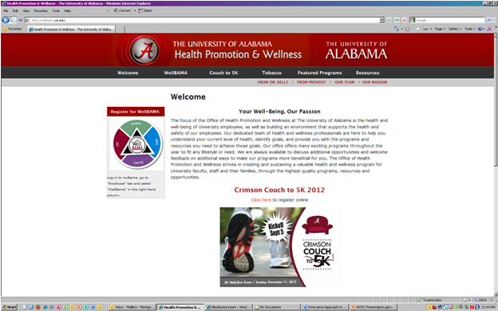

Slide 8
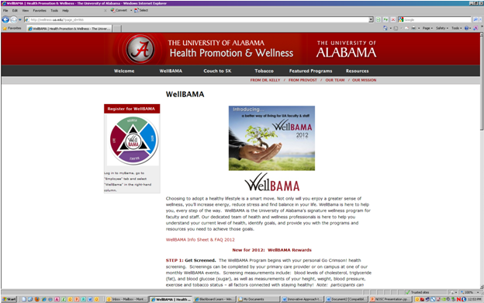
Notes:
WellBama operates in a collaborative model, utilizing partnerships with the Office of Health Promotion and Wellness (OHPW) and the UA College of Nursing (UACN) to develop strategies to encourage employees to make and sustain healthy behaviors.
It utilizes health care professionals, undergraduate nursing students, and graduate students from nursing, dietetics, psychology and kinesiology to design, deliver, and evaluate the program.
The program provides onsite health screening and assessments, timely health advising sessions, and assistance in setting and monitoring individual health goals to promote improved health. Additionally, the program provides an innovative opportunity for nursing students to provide health promotion within an interprofessional framework while improving their clinical and communication skills.
WellBama was introduced to employees through a campus wide outreach in 2009. To date, the outreach has been delivered to all 17 colleges or divisions and over 1,500 employees have participated. Participants were recruited through multiple vehicles of communication, such as promotional flyers and memorandums. Additionally, nursing students visited the buildings prior to WellBama events and handed out promotional postcards to faculty and staff.

Slide 9
WellBama
Operates in a collaborative model
OHPW and UA Capstone College of Nursing
Provides onsite health screenings and assessments
Interprofessional collaboration
Nursing, dietetics, psychology, and kinesiology
Introduced in 2009
Delivered to all 17 colleges or divisions
1500 employees have participated

Slide 10
WellBama and Nursing
OHPW and CCN collaborate to implement WellBama
Nursing faculty member serves as Assistant Director for the OHPW
Faculty train students to use health promotion techniques including:
Determining risk categories
Recognizing metabolic risks
Strategies for improving health behavior
Notes:
The OHPW and the UA College of Nursing (XXCN) collaborate closely to implement WellBama.
The XXCN mission is to enhance the health and well-being of the people of Alabama by advancing the profession of nursing through education, scholarship, and service.
A nursing faculty member serves as the Assistant Director (AD) for the Office. The nurse faculty member has advanced degrees in both adult health and community mental health. The AD works with deans or department chairs to set schedules for onsite screenings, communicates with community health nursing faculty to coordinate clinical schedules for nursing students, and provides intensive student training.
Faculty and students from the community health, nursing course assist with screening, health advising, and follow-up. The nurse faculty train the nursing students to use health promotion techniques including determining risk categories, how to recognize metabolic syndrome risks, and strategies for improving health behavior and biometric risk factors.

Slide 11
Training Nursing Students
Four hour training provided by faculty/Assistant Director
Includes:
Overview of WellBama
Training module for WellBama score sheet
Review of WellBama event guide
Overview of research projects
Lecture and discussion on strategies to improve health risks
Notes:
The four- hour training for the WellBama health screening and health advising event occurs in the community health clinical orientation.
The training session includes a one- hour PowerPoint presentation providing an overview of the WellBama program combined with a 30- minute Camtasia training module.
Additional time is spent in discussion and review of the WellBama event guide, the overview of the research projects, and the students’ role in data collection and data entry.
The final hour is devoted to a lecture and discussion period on strategies for goal setting to improve health risks. These health risks include elevated blood pressure, abnormal cholesterol triglycerides and blood glucose levels, as well as elevated body mass index (BMI), increased waist circumference, lack of exercise and tobacco use.
Since the students are delivering the health advising sessions, they review tip sheets for each health risk the employee has on the score sheet. The students do an in depth review of the tip sheets, created by the Office of Health Promotion and Wellness staff, before attending the screenings. These tip sheets were developed by OHPW staff utilizing guidelines from the National Cholesterol Education Council, the American Blood, Heart and Lung Institute, the American Diabetes Association and the CDC.

Slide 12
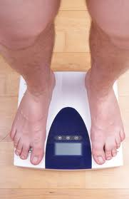
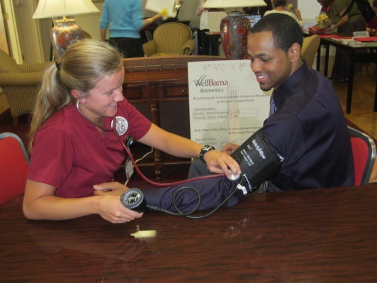
WellBama Screening
Employees complete written forms to consent to participate
Fasting lab values
Triglycerides
Total, LDL, and HDL cholesterol
Glucose levels
Biometric screening
Height
Weight
Body mass index (BMI)
Waist circumference
Blood pressure
Notes:
First, employees complete written forms that consent to share health- related details and to participate in the physical and laboratory collections. Screening forms include program and research informed consents and a health risk appraisal.

Slide 13
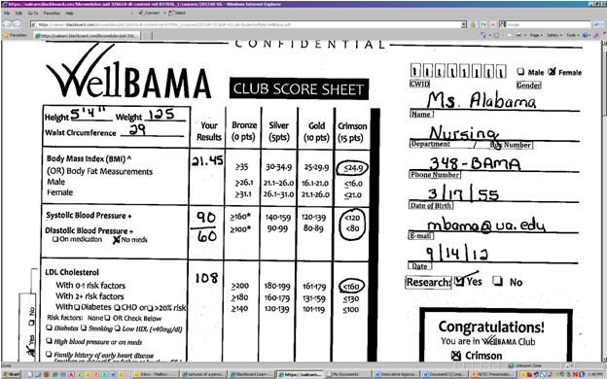

Slide 14
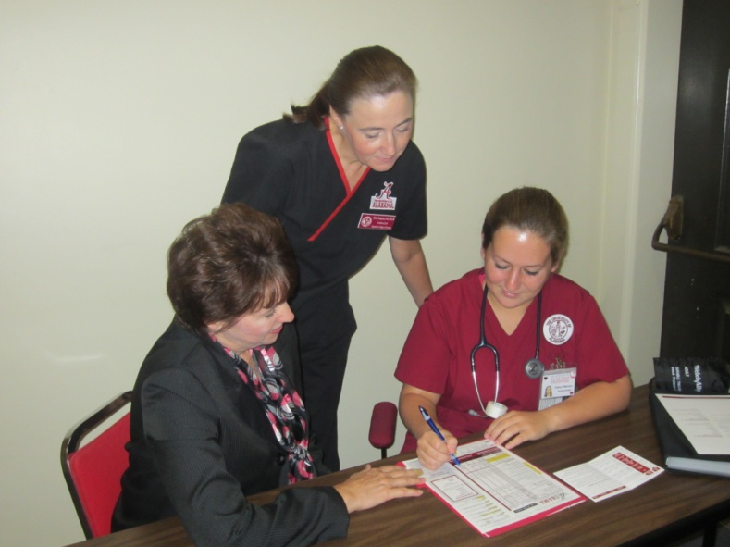
Health Assessment and Advising
Health status categories
Crimson (very low risk)
Gold (low risk)
Silver (moderate risk)
Bronze (high risk)
Nursing student explains lab values and biometric measurements
Assists participant with setting goals
Provides referrals to University health programs
Notes:
Nursing students place employees into health status categories depending on their biometric data, lab values and assessment data. The categories for developing health problems include: crimson (very low risk), gold (low risk), silver (moderate risk) and bronze (high risk).
WellBama health advising involves a review of the health assessment forms, the score sheet, and biometric and lab data.
Nursing students conduct the health advising sessions under faculty supervision. During the health advising sessions, the nursing student provides counseling to assist the participant with setting appropriate health improvement goals.
Reinforcement of goal-setting is completed through health information sheets. Nursing students provide referrals to other University health programs to aid in accomplishing identified goals. For example, to increase exercise, the student will refer the employee to a complimentary three month membership to the University’s Aquatic/Recreation Center, or suggest a campus or community 5K Walk/Run training program or other wellness program.

Slide 15
Research Projects
WellBama research project currently being conducted
Assessing the effectiveness of ongoing screening and health advising to improve health status and develop health promotion programs
Nursing students
Data collection
Data entry
Pilot study findings
Notes:
A WellBama research project is approved by the Institutional Review Board for the University of XXXX and is currently being conducted. A Baseline Description of the University of UA Employees’ Health Status and Interests will assess the effectiveness of ongoing screening and health advising in improving health status and will be used to develop health promotion programs that are identified as needed and of interest to employees. Nursing students are involved in data collection and data entry, and an OHPW graduate assistant performs data analysis. Pilot study findings are shared with the nursing students during their community health orientation.

Slide 16
Benefits of WellBama
Involvement in research
Utilizing research results
Increased knowledge of research process
Positive health habits
Improved NCLEX scores
23% improvement in health promotion content over 2-year period
Interprofessional collaboration
Improved communication skills
Notes:
For many undergraduate nursing students, this is their first, and maybe only, opportunity to assist with a research project, and they gain an understanding of how the results can be utilized to improve the health of the university community. In addition, engaging students in the research has been shown to increase their knowledge of the research process and improves their research skills (Kardash, 2002, Ryder, 1999, Seymour, 2004).
The literature supports health promotion experiences that help students learn positive health habits and demonstrates model approaches to promoting health and wellness (Kupchella, 2009). Kantor (2010) states that the shift toward community, population health, and health promotion has provided a stimulus for nurse educators to reexamine curricula and provide opportunities to meet transformations in health care.
Over 300 senior community health, nursing students and 20 graduate students have experienced health promotion through the clinical rotation in WellBama. The clinical rotation with WellBama has contributed to positive educational outcomes in nursing with a 23% improvement in NCLEX scores in health promotion over a two-year period. In fact, health promotion has been the highest content area on the NCLEX exam for the past several semesters including spring and fall semesters of 2010 and 2011. This improvement could be reflective of changes in teaching strategies; however, students indicate that WellBama made the difference.
Additionally, the program provides an innovative opportunity for undergraduate and graduate nursing students to experience structured health promotion while improving clinical, communication, and professional collaborative skills applicable to other health care settings.

Slide 17
