Slide 1
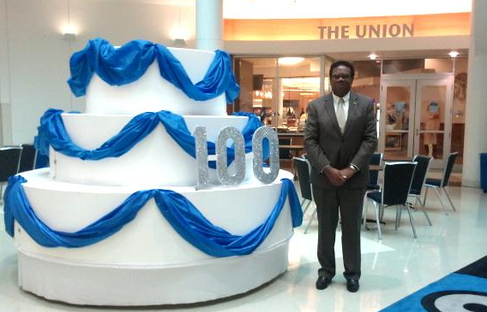
Long-Term University-Community Partnership:
A Student Outreach Experience
In Southwest Memphis
Presented at the National Outreach Scholarship Conference
October 3, 2012
By: Genevie Aaker
Notes:
I am relaying the rich voices of our community partners.

Slide 2
Southwest Memphis

Slide 3
Mission Statements
Westwood Neighborhood Association
To enhance the livability of the community by combating community deterioration, lessen neighborhood tension due to crime and unsafe conditions, increase the sense of civic responsibility, and cultivate neighborhood pride.
C.H. Nash Museum at Chucalissa
To protect and interpret the Chucalissa archaeological site’s cultural and natural environments, and to provide the University Community and the Public with exceptional educational, participatory, and research opportunities on the landscape’s past and present Native American and traditional cultures.
Notes:
WNA
tracks foreclosures
informed about community,
community clean-ups,
involved in city politics,
educating the younger generation,
adopted WW Elementary
President of 8 years: Mr. G. Key participant in partnership.
Chucalissa
Dr. Conolly Executive Director and professor of Anthropology.
The C.H. Nash Museum was founded in 1956 following the 1930s rediscovery of a Mississippian (AD 1000 - 1500) mound complex by workers preparing for the Jim Crow era Shelby County Negro Park (now the T.O. Fuller State Park)
when evidence of the prehistoric occupation was encountered, the area judged to contain the rich prehistoric deposits was removed from the park project to become a tourist destination and research focus for the academicians. These revised plans did not consider the needs of the adjacent community that is 95% African-American
Integrating the facility back into the Southwest Memphis neighborhood as a community partner and cultural asset for all
Chucalissa offers guided tours, traveling exhibits, and a variety of special events for students and the general public.
The engagement includes the co-creation of museum exhibits, consultation on museum redesign, along with hosting community events, projects and programs

Slide 4
Demographics and Socio-Economic Characteristics
Population:
52,306
Primarily African American
Neighborhood association founded in 1986
Median household income:
$28,368
Median home value:
$54,400
Notes:
Household income significantly lower than U.S. average.
Value of homes lower than Memphis metro area.
High number of single mothers.
Talk about homeownership rates and drive in theater story here.
Talk about generation gap.

Slide 5
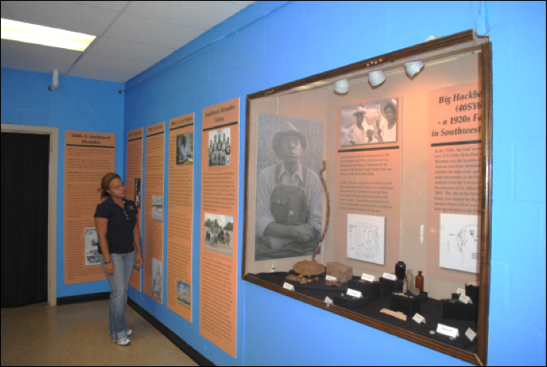
Products of the Partnership
Strengthening Communities Initiative Grant
African American Cultural Heritage of Southwest Memphis Exhibit
AmeriCorps Proposal
Notes:
Five years of collaboration, even with breaks in funding.
AmeriCorps Proposal
invited to submit a joint AmeriCorps proposal for an eight-week community service learning team to live and work in southwest Memphis.
The proposed AmeriCorps projects include collaborating with the Westwood residents to address code violations and present long-term sustainable solutions, maintenance activities at TOFSP, construction of a replica prehistoric house at Chucalissa, and archaeological testing of the grounds of TOFSP.
The Grant
Strengthening Communities is an initiative of the School of Urban Affairs and Public Policy and the Institute for Philanthropy and Nonprofit Leadership at the University of Memphis, the Community Foundation of Greater Memphis and the United Way of the MidSouth
The exhibit
The exhibit proposal centered on a 1920s era African American farmstead excavated at the Chucalissa site in 2002.
The CHNM had curated seven cubic feet of artifacts, field notes, and plan maps from the farmstead excavation.
9 HS students selected out of an application pool of 35, lived in 38109
Wrote essay about why important to know cultural heritage of their community
Essay reviewed by members of the partnership
The high school students spent thirty hours per week for five weeks in the summer of 2010 creating the exhibit
The first two weeks of the project were spent in team building exercises, discussing applied archeology methods, brainstorming, and visiting area museums to view collections and exhibit creation processes.
First ever Black History Month Celebration hosted at Chucalissa

Slide 6
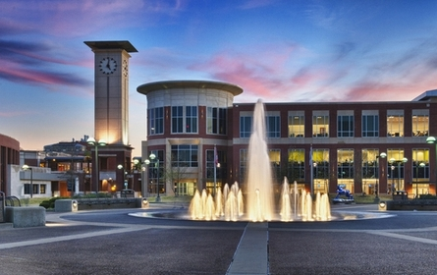
Evidence-Based Concepts
Engaged Scholarship
Crosses disciplines
Involves internal and external forces
Builds relationships
University-Community Partnerships
Revitalize communities
Foster civic engagement
Strengthen the core mission of higher education
Notes:
Applied Research
Human investment
Cultural Identity
Engaged scholarship has influenced the mission and strategic planning of universities
Answer the Question: Why Collaborate?
U-C Partnerships
Defined: a partnership that sustains and renews neighborhoods universities and strengthens university missions
Especially true of urban universities, such as u of m, that you see pictured here

Slide 7
Literature Review
Collaborative Research
Attempts to eliminate inequalities
Strives to improve neighborhoods
Views community members as researchers
Views researchers as collaborative partners
Mutual Benefits
University
Students and Faculty
Community Members (Working through nonprofit organizations)
Notes:
Students
MA theses and practicums
See engagement, outreach, and policy change on a practical level
Exposed to careers in field of interest
Faculty
Publications
Able to identify and respond to real-world problems identified by community members
Able to respond to innovative thoughts, market demands, and economic at social resources
Communities
Active role players in the partnership identifying their own issues and solutions
Human, financial, physical resources
Social capital-Universities connect to politicians, etc.
EX in this partnership: Dr. Conolly connects to Mayor or other professionals regarding lagoon. Use facility at Chucalissa for any events.

Slide 8
The Study
The University of Memphis C.H. Nash Museum at Chucalissa
The Westwood Neighborhood Association
Key Research Question: What aspects of this partnership successfully sustained collaboration?

Slide 9
Methodology
Qualitative, exploratory research
Snowball Sample
Semi-structured open-ended questions asked during interviews
Interviews transcribed and coded
Observations

Slide 10
Findings
Communication
Demonstrated at public event at Chucalissa and during interviews
Unity
With the university
With the community at large
Setbacks seen as joint issues
“[The communication is] a two way communication.”
“[We] naturally work together. [We] work to benefit/improve the community and eventually the city.”

Slide 11
Findings
Perceived Membership Characteristics
Admirable
Motivated
Display initiative
“[I have to] to keep fighting even when it seems like there is no hope. I sacrifice to work for the community. The Bible has to put something in you so you are less selfish.”

Slide 12
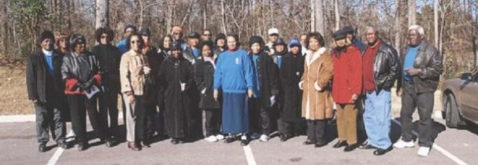
Unexpected Outcomes
Increased trust
Commitment
Effective listening
Mutual learning
Museum has become integral

Slide 13
Limitations
Time
Identification of participants for interviews
Quantitative data needed
Desire to create a reproducible sustainability model for university-community partnerships

Slide 14
Impact on Student Researcher
Notes:
When I was an undergraduate neuroscience student, I enjoyed studying behavioral medicine and cognitive processing. I wanted to conceptualize these subjects because I wanted to know the best ways to promote health, wellness, and literacy. Many think I made a huge jump when I starting studying NP Administration, but not really.
Mr. Gurley wants has similar goals for his neighborhood. Overall, this research helped me see that cultural identity and human investment from revitalizes communities.

Slide 15
Conclusion
Suggested Best Practices
Communicate with clarity and share knowledge
Distribute knowledge more equitably
Unify the community
Identify leaders who can make change happen
The Feedback Loop
“I cannot believe I have been invited to the university campus. No one from the neighborhood association believed I had been invited to speak to a class.”
Notes:
Mr. G connected back to U of M to present. Mr. G has been a WNA member for 8 years.
NP Administration
Student volunteers build professional development and partner with community to promote change. (Mr. G educates them on problems).
More opportunities for research, such as lagoons in Westwood.
Anthropology students already involved at Chucalissa.

Slide 16
References
Austin, D. E. (2003). Community-based collaborative team ethnography: A community-university agency partnership. Human Organization, 62, 143-152.
Boyer, E. L. (1990). Scholarship reconsidered: Priorities of the professoriate. Princeton, NJ: Carnegie Foundation.
Brush, B. L., Baiardi, J. M., & Lapides, S. (2011). Moving toward synergy: Lessons learned in developing and sustaining community-academic partnerships. Progress in Community Health Partnerships: Research, Education, and Action, 5, 27-34.
Cox, D. (2000). Developing a framework for understanding university-community partnerships. Cityscape: A Journal of Policy Development and Research, 5, 9-26.
Haenn, N., Casagrande, D. G. (2007). Citizens, experts, and anthropologists: Finding paths in environmental policy. Human Organization, 66, 99- 102.
Lamphere, L. (2004). The convergence of applied, practicing, and public anthropology in the 21st century. Human Organization, 63, 431-443.
Lane, S. D., Rubinstein, R. A., Lutchmie, N., Back, I., Comell, C., Hodgens, A., Brantley, M., Kramas, R., Keough, K., O’Conner, B., Suk, W., Morrissette, E., & Benson, M. (2011). Action anthropology and pedagogy: University-community collaborations in setting policy, Human Organization, 70, 289-299.
Ostrander, S. (2004). Democracy, civic participation, and the university: A comparative study of civic engagement on five campuses. Nonprofit and Voluntary Sector Quarterly, 33, 74-93.
Rubin, V. (2000). Evaluating university-community partnerships: An examination of the evolution of questions and approaches. Cityscape: A Journal of Policy Development and Research, 5, 219-230.
Schensul, J. J. (2010). Engaged universities, community based research organizations and third sector science in a global system. Human Organization, 69, 307-320.
Seifer, S. D., & Carriere, A. (2003). Symposium overview. OUP in community university partnerships: What do we know? National Symposium on Community-University Partnerships, April 2003. Retrieved August 20, 2012, from http://depts.washington.edu/ccph/pdf_files/symposium_report.pdf.
Simpson, R. D. (2000). Toward a scholarship of outreach and engagement in higher education. Journal of Higher Education Outreach and Engagement, 6, 7-12.

