Slide 1
“Doing Better”: The Paul R. Jones Collection of American Art at the University of Alabama
Dr. Robert F. Olin, Dean, College of Arts and Sciences, The University of Alabama
Dr. Lucy Curzon, Director of Education and Outreach, Paul R. Jones Collection of American Art, The University of Alabama
Ms. Katie McAllister, Director, Paul R. Jones Gallery of American Art, The University of Alabama
Dr. Cathy Pagani, Chair, Department of Art and Art History, The University of Alabama

Slide 2
Our Communities
DOING BETTER

Slide 3
Our Communities

Slide 4
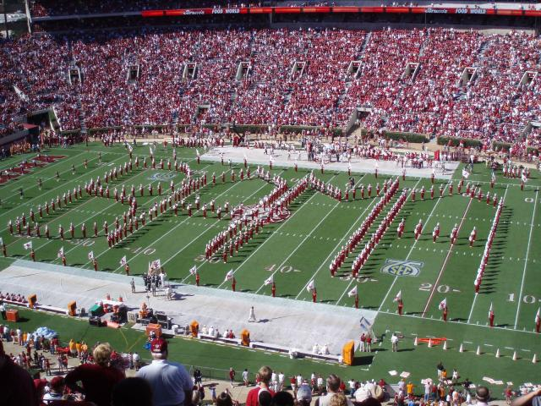
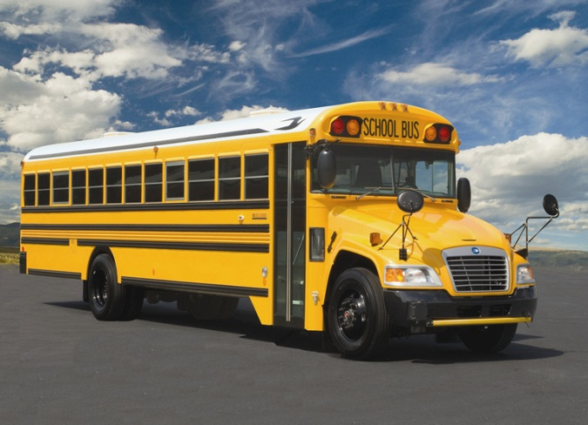
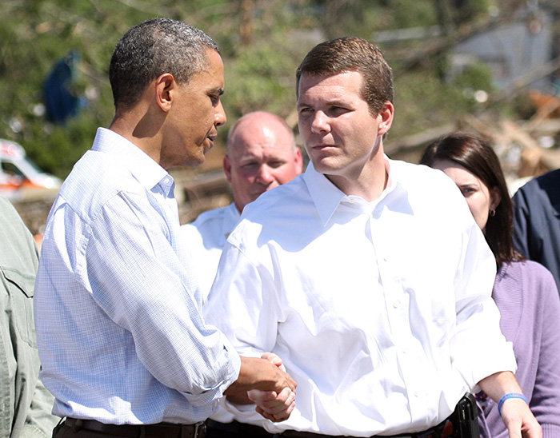
Our Communities
College Students
Citizens of Alabama
K-12 Students
Community Leaders

Slide 5
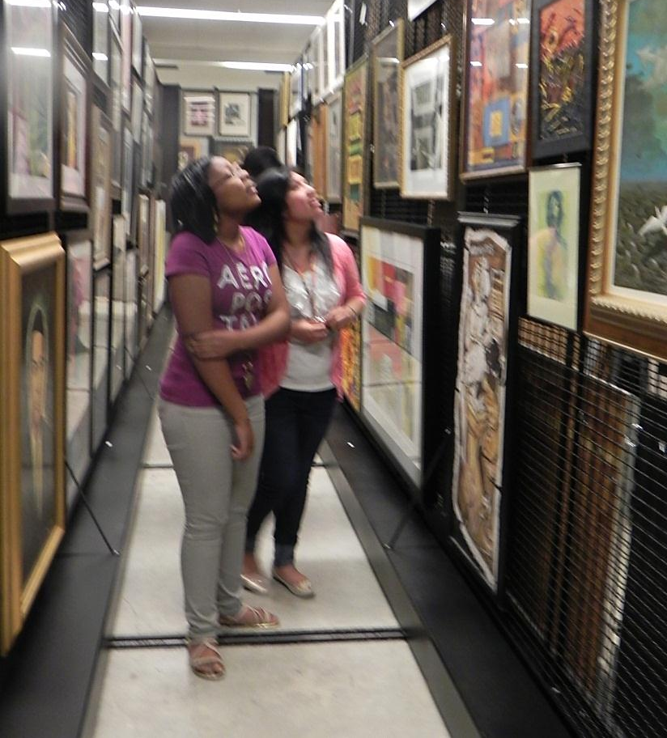
Enacting Community
Guiding premise: the Paul R. Jones Collection of American Art is as much defined by its constituent objects (and the individuals who ‘speak’ for them) as it is by public or outside interaction with those objects

Slide 6
Scope
Community interactions:
teaching and learning
learning, changing, and challenging

Slide 7
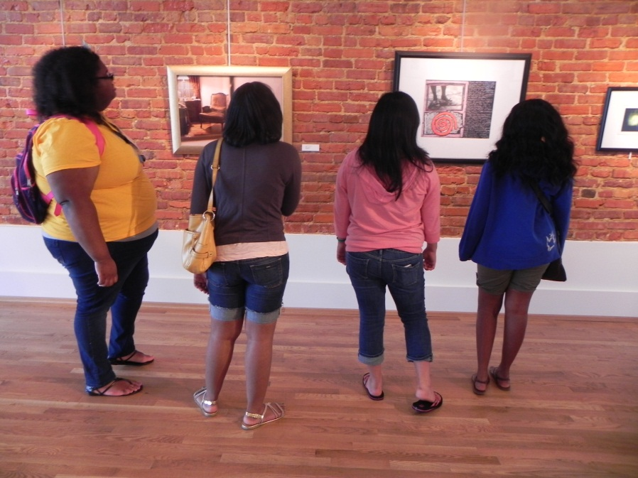
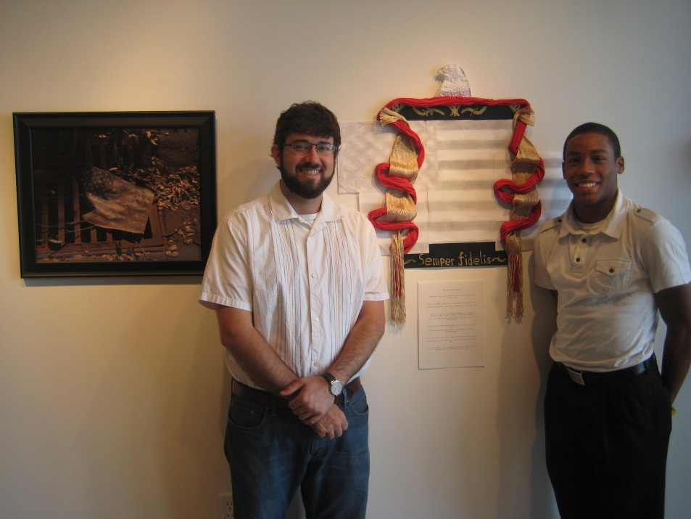
SES with AHF
To the community:
Aspiration
Vocation
From the community:
Creativity
Future states

Slide 8
Art Ride
To the community:
Momentum
Interaction
From the community:
Wonder
Generative state

Slide 9
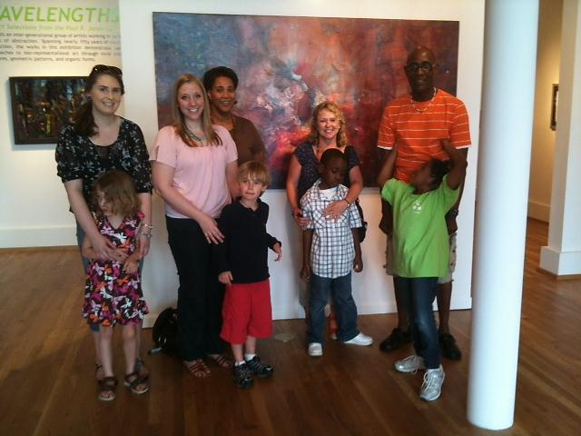
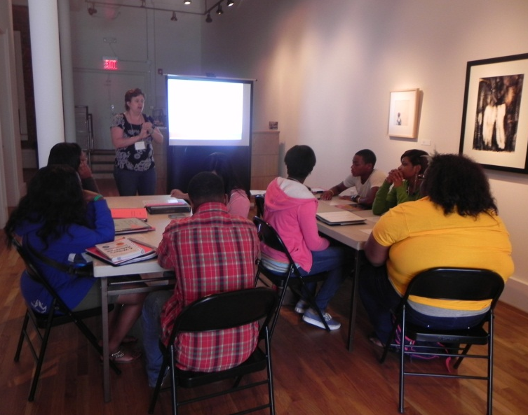
Satellite Classroom
To the community:
Immediacy
Tactile learning
From the community:
Novelty
Innovation

Slide 10
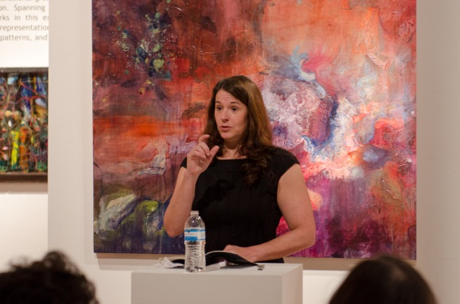
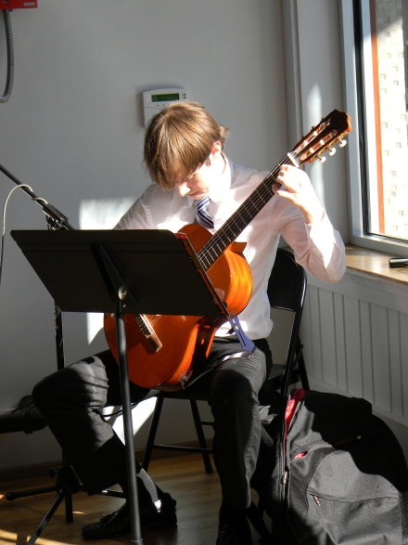
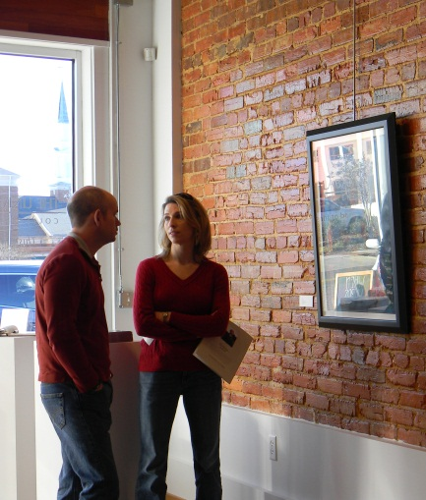
gathering/exchange/creation
To the community:
Location/place
Intrigue & learning
From the community:
Site of
exchange &
creative
production
New community
formation

Slide 11
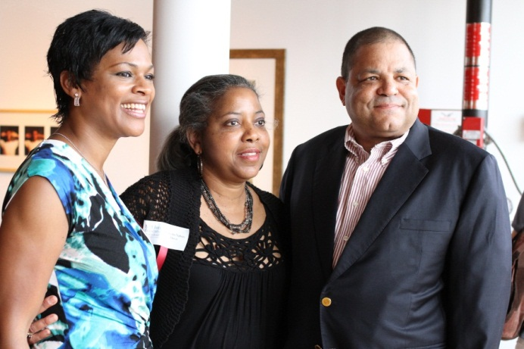
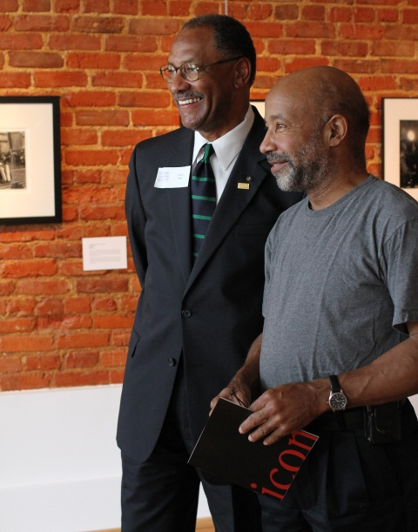
Leading with a purpose: The Jones Advisory Board
To the community:
Outreach
Guidance
From the community:
Support
Pillars/supporters of
the art community

Slide 12
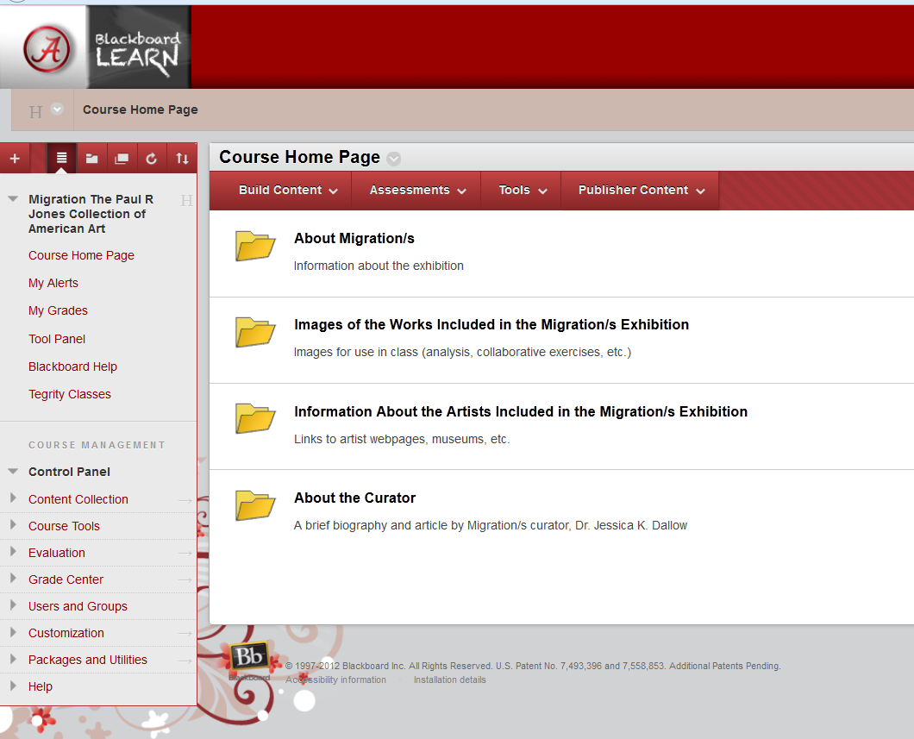
Looking towards the future: Migration 2013
To the community:
A bridge between
disciplines
Context for teaching
and learning
From the community:
Filling the gap(s) between
disciplines/synergy
Stewardship

