Slide 1
Engaging Youth, Engaging Neighborhoods: Photovoice, Narrative and Critical Geography
Stuart Greene
Maria McKenna
Kevin Burke
Ivory Moore
Anyjah Perkins
Becca Tribble
University of Notre Dame

Slide 2
Becca
Notes:
Becca talking about: How they decided to do the project and the maps. Maps are how they understand neighborhoods and community.

Slide 3
Ivory
Notes:
Ivory: Context of the pictures. Process that we went through (talking about interviews and getting to know us) and how they took the photos, but generally only the good pictures first. She said something about moving away because of shootings; she can talk about why she left but why she wants to do this in Blue Island.

Slide 4
Anyjah
Notes:
Note: This photograph was taken by a student we worked with us in a Photovoice project that we would like to discuss in the time that we have. Photographs like these represent counter-narrative that challenge deficit perspectives of youth living in urban neighborhoods and the assumptions that educators, policymakers and others make about low-income youth of color.
Note: This Photovoice project grew organically out of a community-university partnership with a local neighborhood advocacy group. In meetings with the advocacy group’s leaders, researchers formulated the research questions and discussed means of evaluating the efficacy of our work. We placed specific emphasis on Photovoice methodology as it applies to spaces and objects within the participants’ neighborhood for safety and philosophical reasons. Meetings with stakeholders, including the youth participants, reinforced a sense of reciprocity and mutual benefit, a key element in community-based research.
Note: We are reminded of LeAlan Jones and Lloyd Newman (1997) who chronicled their lives as twelve year olds in the housing projects in Chicago and youth’s capacities for making a difference in their own lives and for the lives of others in spaces of possibility. Similarly, Phillip and Khaleeq, offered a poignant account of how gentrification in Harlem has not only erased the cultural history of Black people, but has displaced long-time residents who no longer have any sense of belonging to the place they once called home (Kinloch 2010).

Slide 5
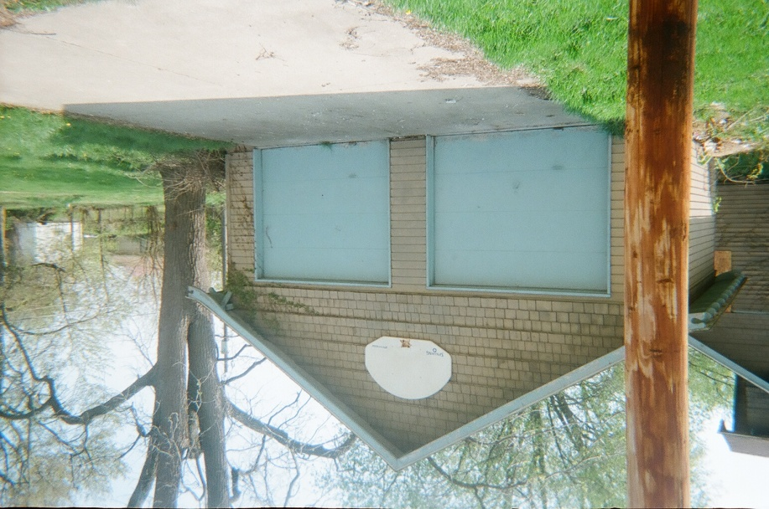
Centering the Voices of Youth
Notes:
Photograph is the child’s voice.
We’re countering the silenced dialogue through storytelling/story ‘hearing’
The point is to interrupt a narrative that ignores children, particularly marginalized, minority, and poor children
It’s a critique of the adult explanation of what we’re trying to accomplish
Things we wouldn’t have noticed were it not for them.
Name the kids.
Talk about how these are pictures and they are the students’ stories.

Slide 6
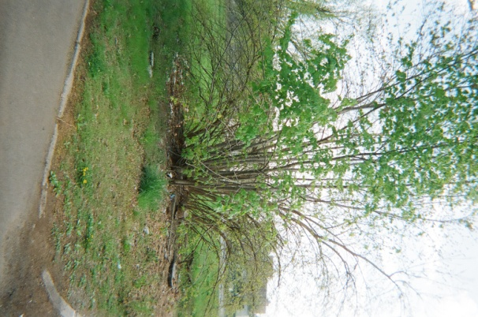
Theoretical Framework
Notes:
Narrative: Daniell (from Lyotard) and the postmodern condition: breaking the grand narrative into ‘little narratives’ that come to construct a number of versions of reality. This isn’t just a bush, nor is it a tree but the trash that comes into with it in the larger context of a neighborhood.
Critical Geography Studies: Space as appopriated for a purpose. The thirdspace of Soja or Race and space in Schein or Lefebvre--

Slide 7
Theory of Change
Notes:
Note: We link this notion to Lipsitz who conceptualizes the black spatial imaginary as the consequence of state-sponsored policies of exclusion that have contained people of color in segregated neighborhoods. History is a witness to exclusionary policies that have prevented people of color from gaining access to assets that appreciate in value or reap the benefits of home ownership. As Lipsitz (2007) points out, “Their only recourse under these circumstances is to increase the use value of their neighborhoods by turning ‘segregation into congregation’ and fashioning ferocious attachments to place as a means of producing useful mechanisms of solidarity” (p. 11). Indeed, race determines where people live, go to school, and work and Whiteness, and White privilege, “skew opportunities and life chances.” A white spatial imaginary embraces exclusivity and exchange value in a landscape that fetishizes the private, gated community over the public spaces of human connection at the expense of people of color. Ultimately, Lipsitz argues that development needs to embrace a black spatial imaginary and the sense of social solidarity, democracy, and egalitarianism that it represents.

Slide 8
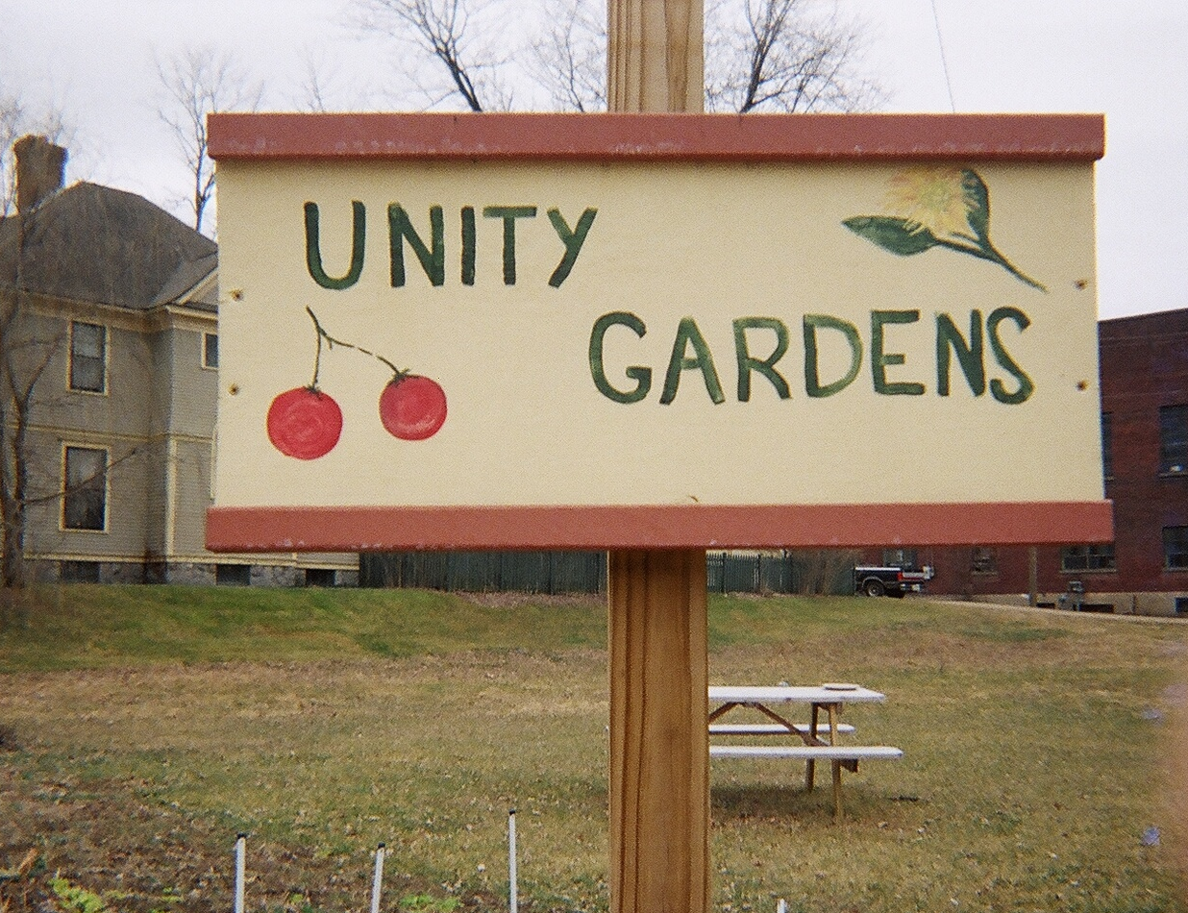
Notes:
Note: No matter what we try to create, each of these kids comes with a history of relationships to others and these kids yearn for stability. We need educational models that help with relationships to foster this. We need to give voice to the histories that students have. You can’t simply say, ‘let’s have a relationship.’ By asking them to take pictures it was a signal that we (strange adults) cared what they thought and trusted them to show us. The tenets of critical race theory are also essential because they remind us as outsiders to be mindful of difference and aware of our privileged position as white, well-educated adults.

Slide 9
