Slide 1
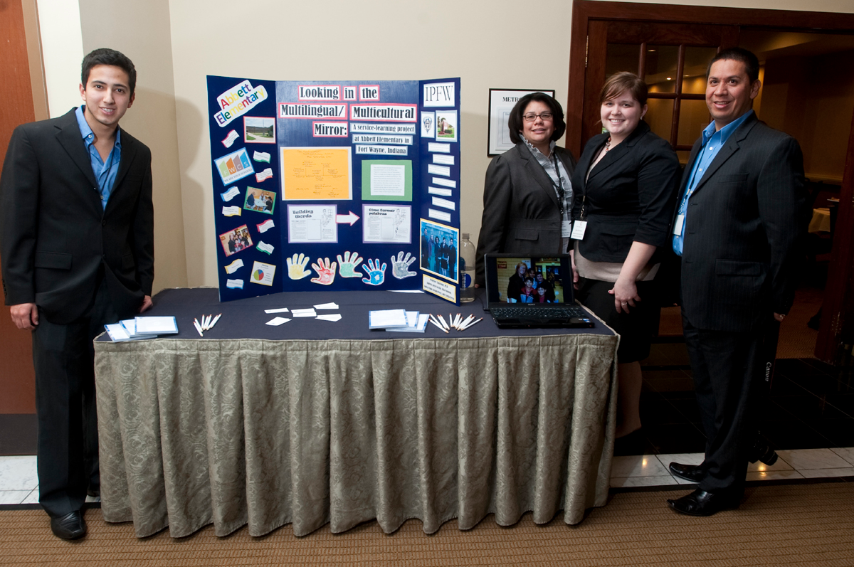
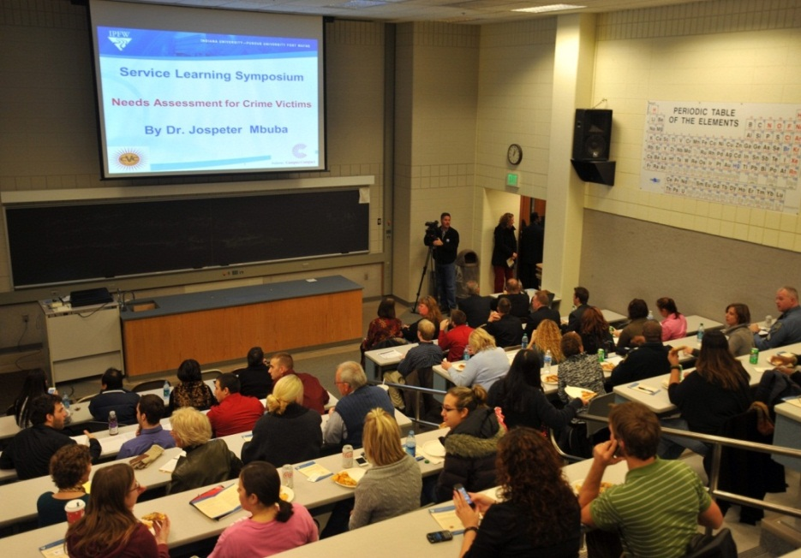
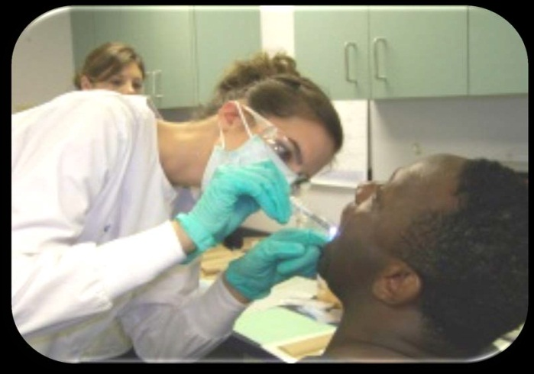
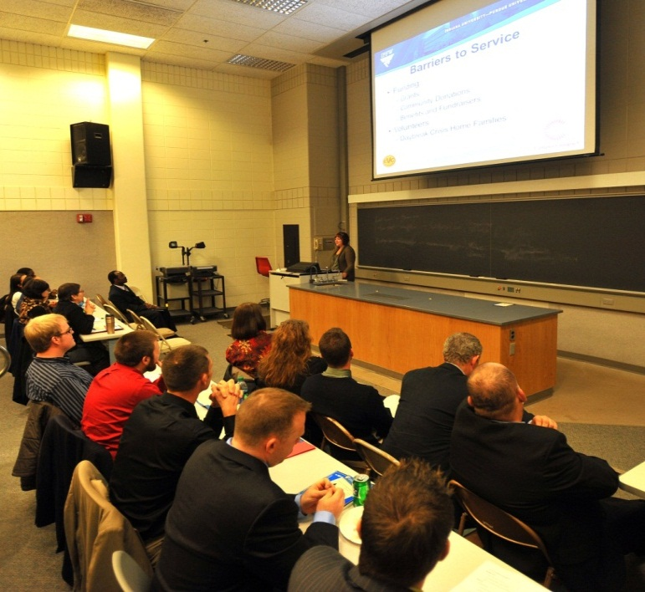
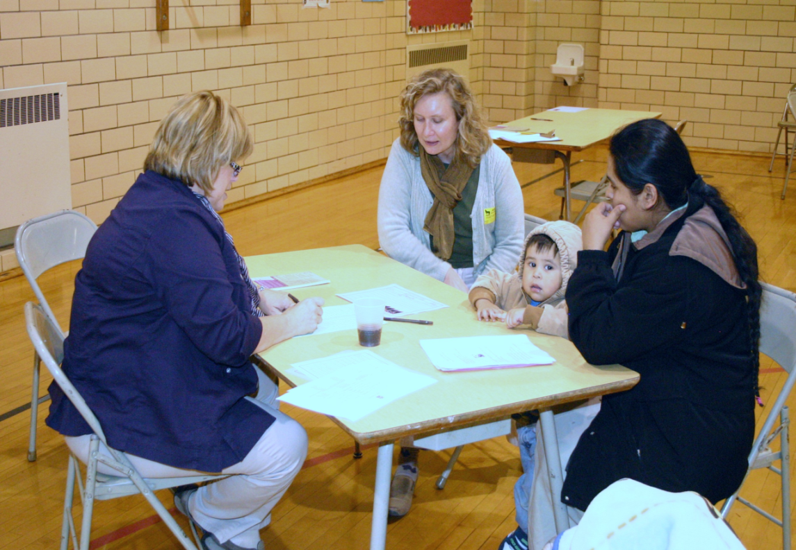
Service Learning in Northeastern Indiana: Spanish, Criminal Justice, Health, Education
Looking in the multilingual/multicultural mirror: Spanish
translation to serve the Elementary school
Talia Bugel & Robin Peterman
Needs Assessment for crime victims among Refugees and Immigrants in Northeastern Indiana
Jospeter Mbuba
Cultural Competence:
Dental Education and Educational Studies
Nancy Mann & Gail Hickey
Translation and service-learning – How do these connect?
Theoretical Foundations of Criminal Justice Policy
Students conducted a needs assessment f
or crime victims among refugees, immigrants, and other non-English speaking populations of Northeastern Indiana.
Goal:
Introduce students to diverse cultures in America & raise awareness of differences and impact on potential for error in clinical judgment
Cultural competence
is a process; it helps in recognizing cultural uniqueness and respectfully interacting with people of different cultures, and it helps in developing culturally competent treatment plans
Service-learning requires:
Course work that fulfills a community need;
A community need that serves as an appropriate learning experience.
Each student assigned to a victims services agency.
Goal:
Develop culturally competent practitioners who can deal with differences & similarities within, among, and between groups BEFORE they engage in community.
Translation requires:
Command of source texts – their social and cultural meaning as well as the words;
Solid knowledge of the target language and audience – not just words but their significance as a minority language, sometimes stigmatized as uneducated.
12 Agencies participated
Students administered a SWOT questionnaire:
- Strengths
- Weaknesses
- Opportunities
Threats
Strategy:
Integrate textbooks, training videos, gaming, and literature to enrich self-awareness, reflection, and sensitivity to cultural issues, including values, prejudices, and stereotypes.
Funded by Indiana Campus Compact
Rationale
Diversity training: raises awareness of biases, prejudices, and how beliefs affect behaviors.
Sample of Needs
Reading and writing
- Translation
- Interpretation
- Transportation
- Cultural adaptation
- Family relations
Strengths
-Dedicated staff
- Many volunteers
Local organizations
Weaknesses
Lack of resources
- Money
- Translators
Interpreters
Group support
Students’ Comments on Service-Learning
Reading and Writing – Parent Pack – Focused follow-up for at-home learning – Kristina Smekens, Smekens Publishing
“This class […] has also allowed me to be more aware of the effects that a language barrier creates.”
“Service-learning and translation go well together as a class. It allowed us to gain real, hands-on experience.”
Accountable Talk – Discusión responsable y preguntas reflexivas
Opportunities
- Family friendly community
- Responsiveness of immigrants
- Immigrants helping immigrants
Translation students at IPFW
needed translation practice
provided bilingual skills.
Parents and staff at Abbett Elementary
needed Spanish translations
provided the context for their development
Threats
- Blindness of law
- Duplication of efforts
- Cultural incongruity
- Language barriers
Service learning allows students to use what they are learning in class and readings in a real setting outside of school while at the same time helping others.”
We were able to practically apply the Spanish language skills that most of us have been developing for years.
Outcome
- Student presented findings in a symposium
- All participating agencies were invited and attended
- Way forward discussed and solutions identified
- Harmonization of efforts deliberated
- Future roadmap proposed
“I would encourage all students of Spanish to participate in a class like this.”
Vocabulario usado en los Estándares de Educación del Estado de Indiana

