Slide 1
A Skills-Based Approach to Community Leadership Development Programs
Jason Kauffeld, UWEX
Patrick Nehring, UWEX
National Outreach Scholarship Conference
October 3, 2012
Tuscaloosa, AL

Slide 2
A Skills-Based Approach to Community Leadership Development Programs
UWEX University of Wisconsin - Cooperative Extension Service
TCLI Tri-County Leadership Initiative
CRD Community Resource Development
CEU Continuing Education Unit
(100 years young!)

Slide 3
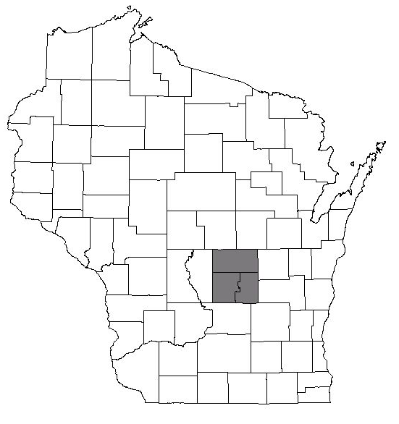
The Tri-County Area
Wisconsin
Waushara
Waushara
Green Lake
Marquette
Green Lake
Bucky lives here *
Maps created by
UW-Extension Waushara County
Notes:
The UWEX CRD Educators in these three counties partner to deliver the program. The Green Lake County CRD Educator is the lead educator for the TCLI (probably does 90% of the ‘lifting’.)
Three small rural counties, each with less than 20,000 in population, teamed up to have a critical mass of 50,000 in population.
The center of population for Wisconsin lies within the Tri-County Area

Slide 4
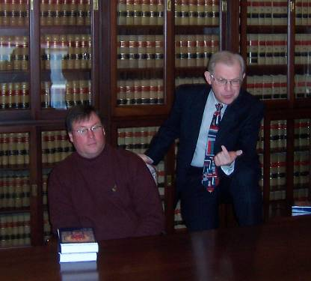
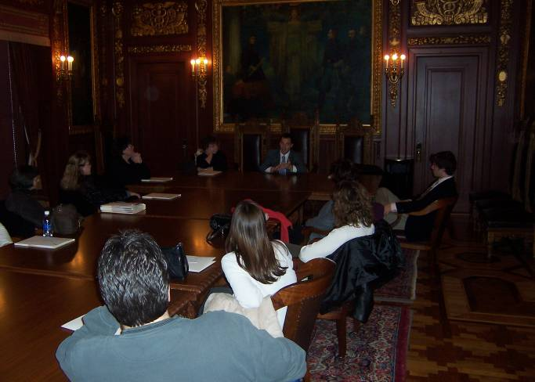
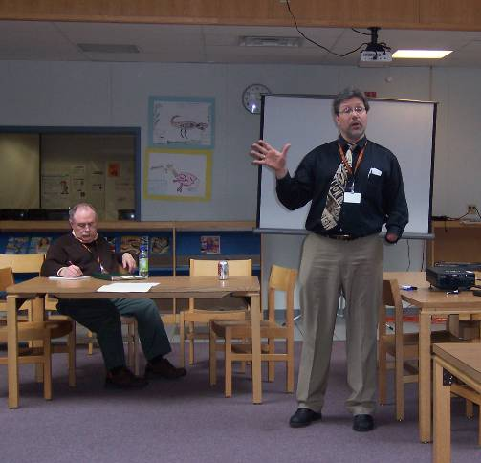
First Four Years: Issues-Based
Notes:
In the beginning… (first class held in 2004)
A need was identified through interviews during a multi-year planning period.
Green Lake County CNRED Agent Jeff Hoffman took the lead, but everyone in the UW-Extension offices of Green Lake, Marquette, and Waushara Counties joined in.
A steering committee of local residents, elected officials, business leaders, and others was formed.
Other leadership programs were studied and from their examples a syllabus was created, a grant written, promotional materials created, and the Tri-County Leadership Initiative was born.
As evaluations were reviewed and educators moved on, the TCLI evolved…

Slide 5
Issues-Based Syllabus, Nine Months
Learn About Yourself First
Personal Mastery
Community
Agriculture & Natural Resources
Government & Capitol Visit
Healthcare and Wellness
Education
Economic Development
Project Presentation and Graduation
Notes:
Typical Schedule Fall 2004 – Spring 2008:
Meet once a month for 8 hours, typically from 8:30 to 4:30 from September to May with the following exceptions:
Trip to Madison, may be 10 hours
Graduation, may be 5 hours
Location rotates based on the day’s theme and may include tours based on the theme
Project work begins on the first day and ends with graduation with milestones each month.

Slide 6
Change from Issues to Skills-Based in 2008
Notes:
First four TCLIs (2004-2008) were 90% issues and 10% skills.
Following four TCLIS (2008-2012) were 90% skills and 10% issues.

Slide 7
Skills Taught Over Six Weeks
Notes:
A Wordle created from the current syllabus for the course: nearly 40 skills are taught.
Session Topics
Understanding Yourself
Understanding the Organization
Understanding Your Role in the Organization
Sustaining an Organization
Understanding Your Government
Understanding Systems and the Triple Bottom Line/Choose Project
Understanding Yourself
Intro and Expectations
Leadership
Becoming a Global Citizen: Global, National, State, and Tri-County Trends
Evening movie on leadership.
Time Management
Colors / Self Analysis
Conflict Management
Understanding the Organization
Facilitation in good times and bad (more on Conflict Management)
Running a meeting
Agendas, minutes
Robert’s Rules
Roles and Responsibilities of board members
Why people organize
Lifecycle of an organization / organizational development
Types of organizations
Understanding Your Role in the Organization
Serving on a board
Fundraising and Grant Writing
Event Planning
Working with the press
Ethics
Recruiting volunteers
Sustaining an Organization
Strategic Planning
Operational Planning
Evaluation
Budgeting
Setting Goals
Marketing
Understanding Your Government
Private Meeting with Legislators and Tour of the Capitol
Open Meeting Law
Records
ADA/Civil Rights
Towns Association
Counties Association
League of Municipalities
Crafting Your Message
Communicating with Officials
Identifying Issues
Understanding the True Bottom Line / Choose Project
Systems Thinking
Sustainability: triple bottom line, cradle to cradle planning, and full-cost accounting
Cover topics from previous sessions that would benefit from more time
Panel discussion with leaders from the Tri-County region
Discuss the class project
Classroom Portion covers 40 hours
Sunday & Monday: 18 hours
Following Monday: 10 hours (Madison Trip)
Following Tuesday: 5 hours
Following Wednesday: 5 hours
Following Thursday: 5 hours
Following Friday: 5 hours
Graduation lasts 2 hours and held immediately before next class
Location may remain constant depending on participants’ desires
Project work begins at the sixth class period and continues for 6 to 9 months with periodic milestone meetings and check-ins until graduation.

Slide 8
Notes:
Emphasis on using literature to learn more about topics and skills students are introduced to. Each participant is allowed $50 towards building a personal leadership library – a list and summary of recommended books is provided. Many participants buy used books on Amazon.com and obtain 8 or 9 books with their allowance. Some years, the students independently form study circles when they choose similar books.

Slide 9
Notes:
Trust-building and communication building activities are featured in the TCLI.

Slide 10
Notes:
Helium Hoop: designed to increase understanding of the key connection between communication and leadership.

Slide 11
TCLI Enhancements Since 2008
Absent from school/workplace four days versus nine days
TCLI is held 18 months apart
Six week classroom/ six month project periods (each 40 hours)
Project engages the full group
Incoming and graduating classes overlap
Receive CEUs
Notes:
18 months apart means a summer TCLI (should help students participate) is followed by a fall TCLI – allows for different audiences to participate.
Begin project period with a full toolbox due to all classroom sessions being completed before project begins. The project is expected to take around 40 hours of time.
Due to the entire class working on the same project, they must practice many of the communication and team building skills they learned about.
Since the new format was adopted, TCLI graduates are eligible for 4 Continuing Education Units for their 40 hours of classroom instruction.

Slide 12
Future Goals
Increase alumni involvement
Reach new audiences
Establish an endowment
Suggestions?
Notes:
Tuition is $400 – scholarships of up to $390 are available.
Fundraise nearly 100% of course expenses.
For alumni- encourage them to team teach a skill?

Slide 13
Evaluating the TCLI
Issues-Based (2004-2008)
Skills-Based (2008 – present)
Participatory Evaluation
Notes:
We teach Evaluation as one of the skills, and use the participatory design of the TCLI Evaluation Instrument as a hands-on learning experience.
Evaluate after the classroom period – use a retrospective self-report of change in confidence due to participating in the TCLI.
We don’t want to keep moving ahead blindly – want to do better and better job of evaluation…
Currently conducting an all-alumni survey to measure effectiveness of Issues-Based versus Skills-Based Methodology. Data so far indicates the Skills-Based is more effective.
92 graduates as of 2012 (counting this year’s class)

Slide 14
Six-Week/One Year Survey Instrument
Please rate how confident you feel about your ability to: | April 14 | Now
Take on new leadership roles or become more involved in my community
Interact more effectively with others
Incorporate Triple Bottom Line thinking into planning and decision making
Run a meeting using Robert’s Rules of Order
Prepare an agenda that leads to decisions and/or outcomes
Contribute valuable insights or ideas to a board or an organization
Communicate a message to elected officials
Act as a role model for my team and always set a good example
Encourage my team to think about new ways of doing things
Communicate a clear and positive vision of the future
Actively support and encourage the development of my team
Develop a shared vision and goals for what our team is trying to achieve
Be aware of how local, state, and global trends impact your community
Deal with conflict to arrive at a solution or understanding
Develop a strategic plan for community projects or causes
Raise funds for community projects or causes
Recruit and manage volunteers for community projects or causes
Write an effective press release
Networking (selected by the class)
Make meetings / organizations more effective (selected by the class)
Understand my government (selected by the class)
Notes:
Participatory Design of the evaluation.
Paired Post-test/ Retrospective Pre-test Method.
Also, use a participatory process with the class participants to develop the instrument.
Six weeks measures completion of the classroom period.
One year measures completion of the project period.

Slide 15
UW-Extension Community Based Leadership Development Team
Initiative began in 2004 in response to communities and educators asking for support
Members are Extension and non-Extension professionals who administer leadership development programs
Mission: To support the development and improvement of leadership development programs statewide (become the “go-to” statewide resource)

Slide 16
Iowa State/UW-Extension Leadership Specialist Position
Position came about partly because of the Community – Based Leadership Development Team’s advocacy
Unique funding model (probably the first of its kind in the country):
1)Iowa State, 2)UW-Extension, and 3)the City of
Dubuque, Iowa are the funding sources
Will provide research-based information that can be used in support of fledgling and established leadership development programs

Slide 17
Thank you for your time!
Jason.Kauffeld@ces.uwex.edu
Patrick.Nehring@ces.uwex.edu

